Slide 1

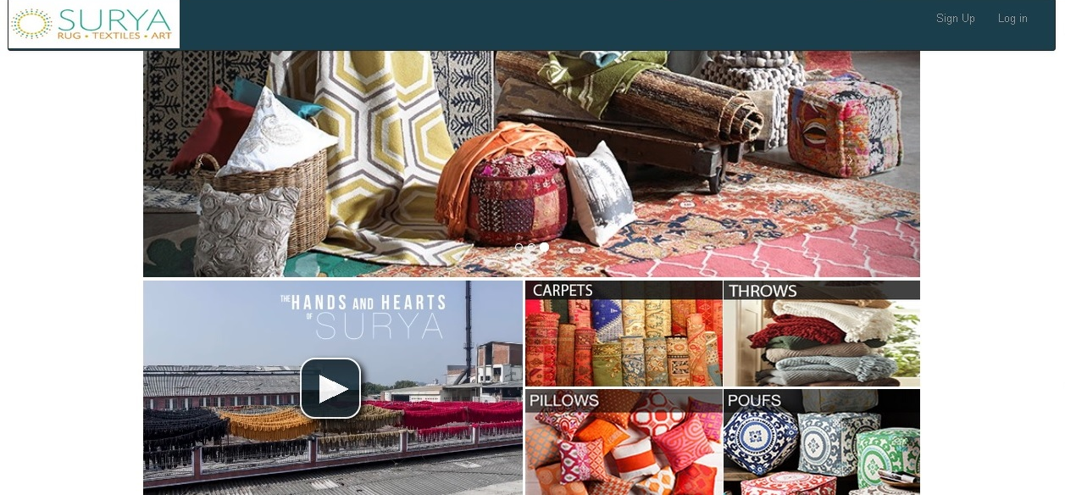
SURYA CARPET RUG-TEXTILES-ART This Manual is for using the Surya Carpet website. This is the Home Screen of the Website.

Slide 2
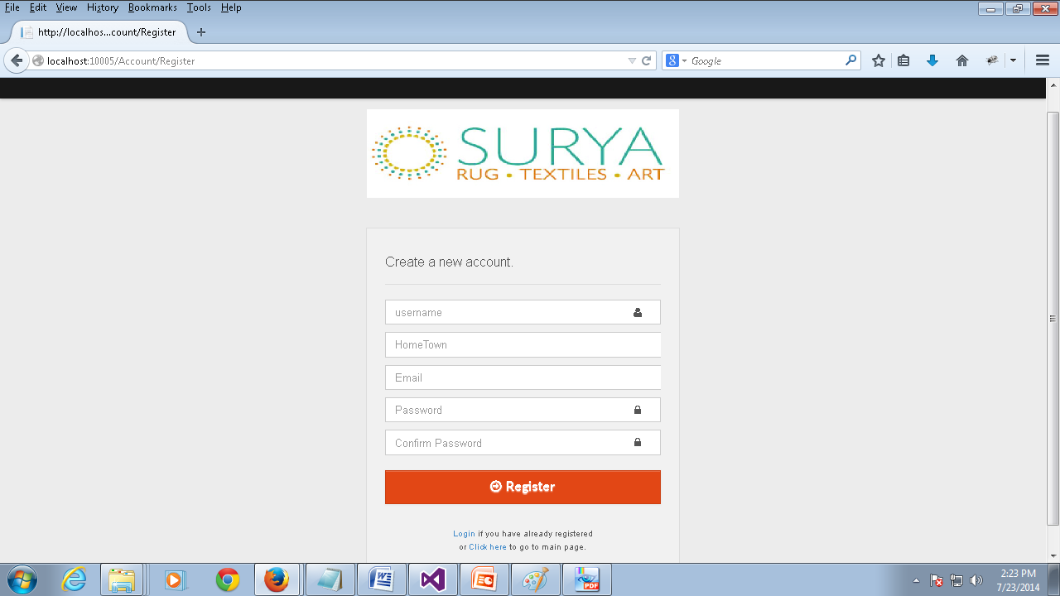
Sign Up Page
To Access the Surya Carpet Website you must first register your account. To register your account you must fill in all your details in the Registration form as show in the picture and click Register.
Field Name | Narration | Field Name | Narration
User Name | User name with which you would like to access the website. Example Formats : yourname201, yourname. | Password | The password for your account
Home Town | The name of the home town of the user. | Confirm Password | You should retype your password here.
Email | Your email address. Please make sure to provide a valid email address as the email you provide will be the mode of communication between you and the company. | Register | Once you have filled all the above details please click this button to register with Surya website.
***Once you have registered please wait for role assignment before you login which you will be notified through your registered email.

Slide 3
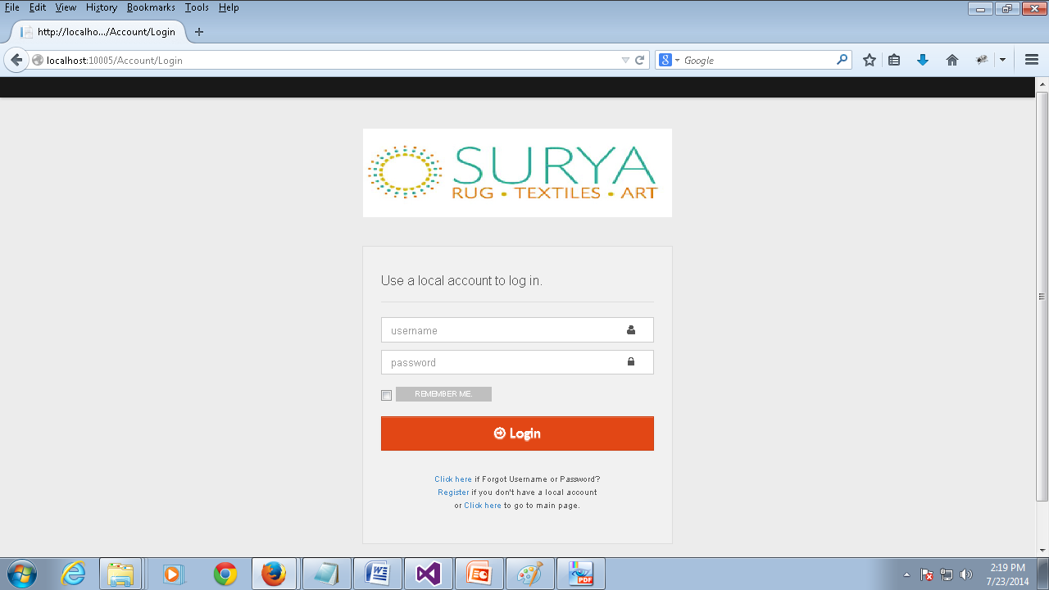
Login Page
Field Name | Narration
User Name | The user name entered by you while registering to Surya Website
Password | The password entered by you while registering to Surya Website.
***Once the role assignment is done you will be receiving a confirmation email. Please note that you will be able to use your account to access the website only after receiving the confirmation email. And the user name and password fields are case sensitive.

Slide 4
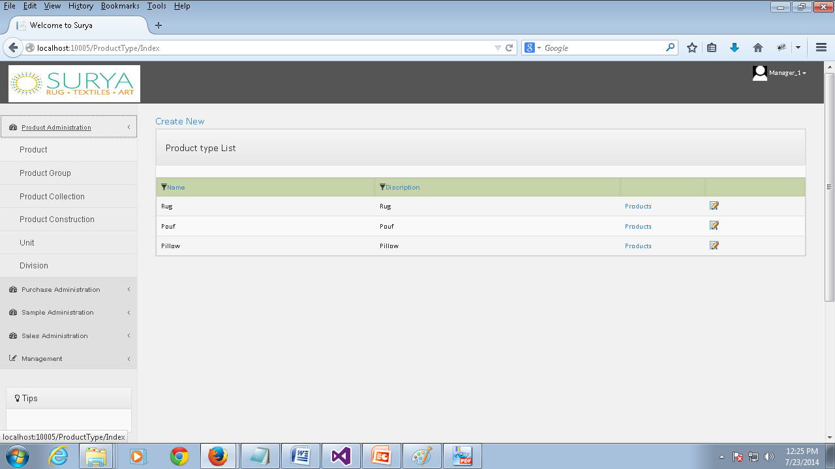
Product Type List
Product | This page keeps information about each product type used in our business.
Permission | Action | Narration | Roles
 | Create | You can create a new product type using this link. | Admin
 | Modify | You can make changes to the product type information by clicking the corresponding modify icon. | Admin
 | Products | You can view all the products that belong to the particular product type(which will be shown in the next slide.) | Admin, Manager, Data Entry Operator.

Slide 5
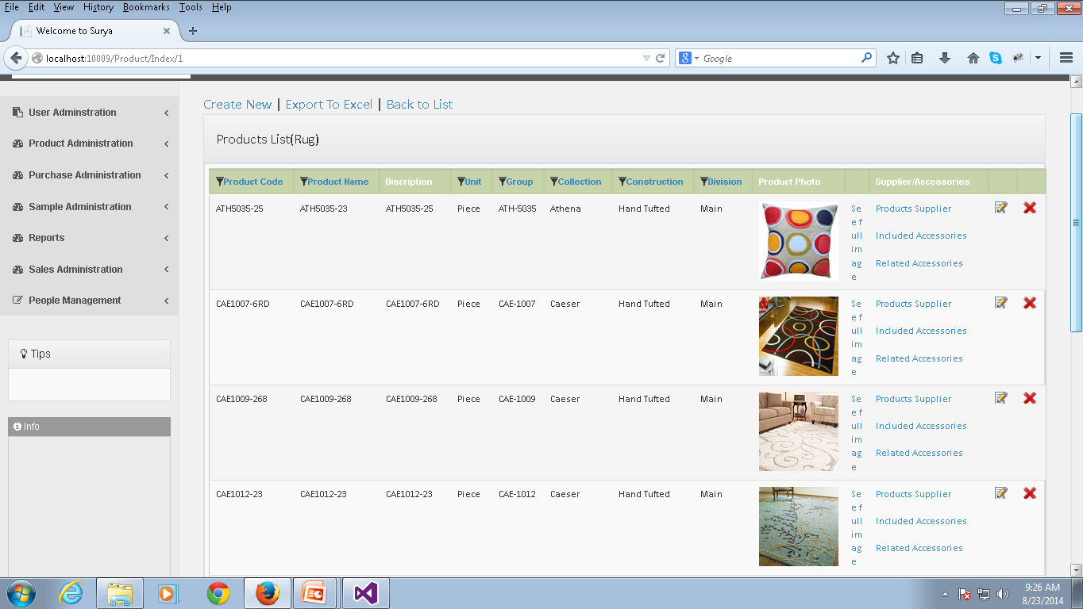
Product List
Product List | This page keeps information about products that belong to particular product type used in our business.
Permission | Action | Narration | Roles
 | Create | You can create a new product using this link.(which will be shown in the next slide) | Admin, Data Entry Operator.
 | Modify | You can make changes to the product information by clicking the corresponding modify icon. | Admin, Data Entry Operator.
 | Export To Excel | You can export all the list of products to an Excel file | Admin, Manager, Data Entry Operator.
 | Delete | You can delete the product by clicking the corresponding icon. | Admin
 | See Full Image | You can use this option to view the images in full screen. | Admin, Manager, Data Entry Operator.
 | Product Supplier | You can find the list of suppliers for the product using this link.(which will be shown next to the create slide) | Admin, Manager, Data Entry Operator.
 | Included Accessories | This shows the list of Accessories that are included with the product.(You can find more about this next to the product supplier slide) | Admin, Manager, Data Entry Operator.
 | Related Accessories | You can see the list of all the related accessories for the particular product.(You can find more about this next to the included accessories slide) | Admin, Manager, Data Entry Operator.

Slide 6
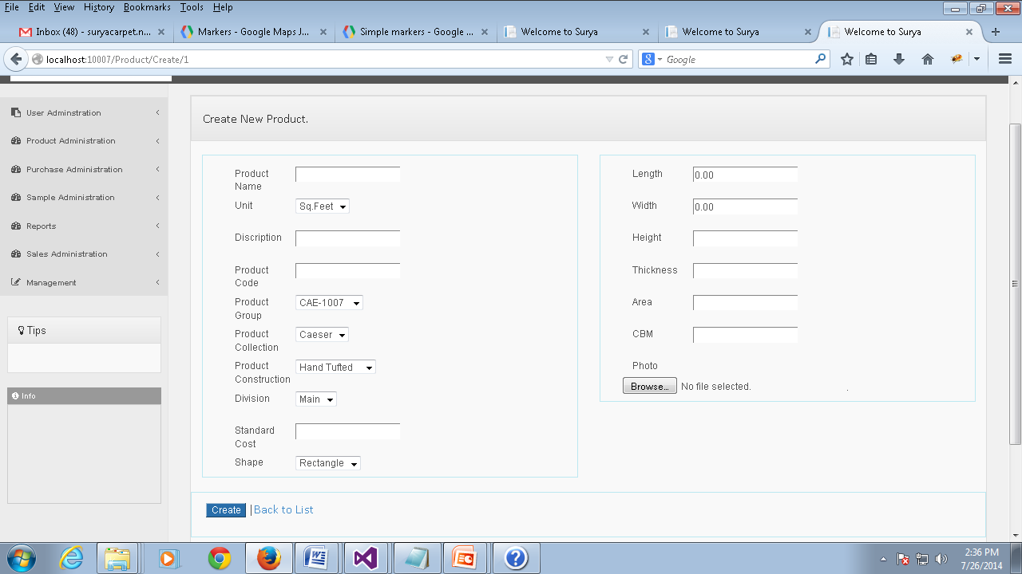
Create New Product
Field Name | Narration | Field Name | Narration
Product Name | Name of the product | Standard Cost | The Cost parameter of the product
Unit | Product Unit | Shape | Defines the shape of the product
Description | Description about the product | Length | Defines the length of the product
Product Code | Unique code of the product | Width | Defines the width of the product
Product Group | Defines which group the product belongs | Height | Defines the height of the product
Product Collection | Defines which collection the product belongs | Thickness | Defines the thickness of the product
Product Construction | Defines which construction the product belongs | Area | Defines the area of the product
Division | Defines the division of which the product belongs. | CBM | Cubic meter.
 |  | Photo | Photo sample of the Product

Slide 7
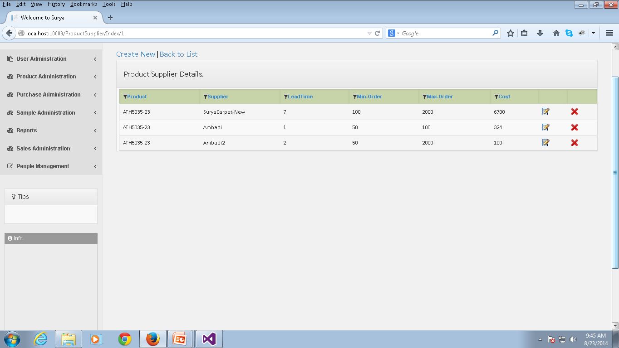
Product Supplier Details
Product Supplier | This page keeps information about the product suppliers of a particular product.
Permission | Action | Narration | Roles
 | Create | You can create a new product supplier for the particular product.(which will be shown in the next slide) | Admin, Data Entry Operator.
 | Modify | You can make changes to the product supplier information by clicking the corresponding modify icon. | Admin, Data Entry Operator.
 | Delete | You can delete the product supplier by clicking the corresponding icon. | Admin, Data Entry Operator.

Slide 8
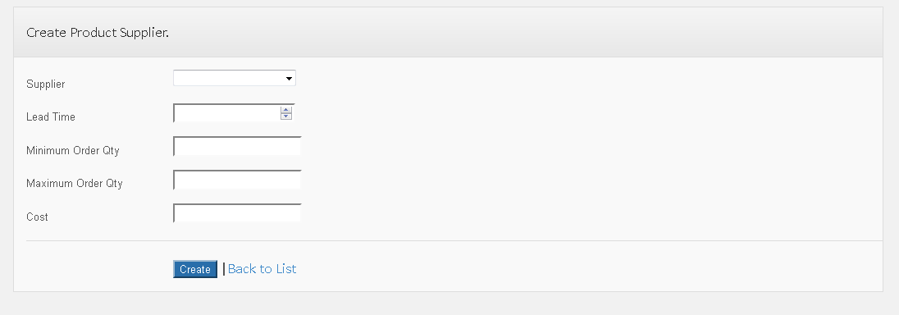
Product Supplier Create
Field Name | Narration | Field Name | Narration
Supplier | This List has the names of the suppliers | Maximum Order Quantity | This field specifies the maximum number of quantities for an order.
Lead Time | This field represents the time committed by the supplier before which he can supply the product. | Cost | This field specifies the cost of the particular product from the supplier.
Minimum Order Qty | This field represents the minimum number of quantities for an order

Slide 9
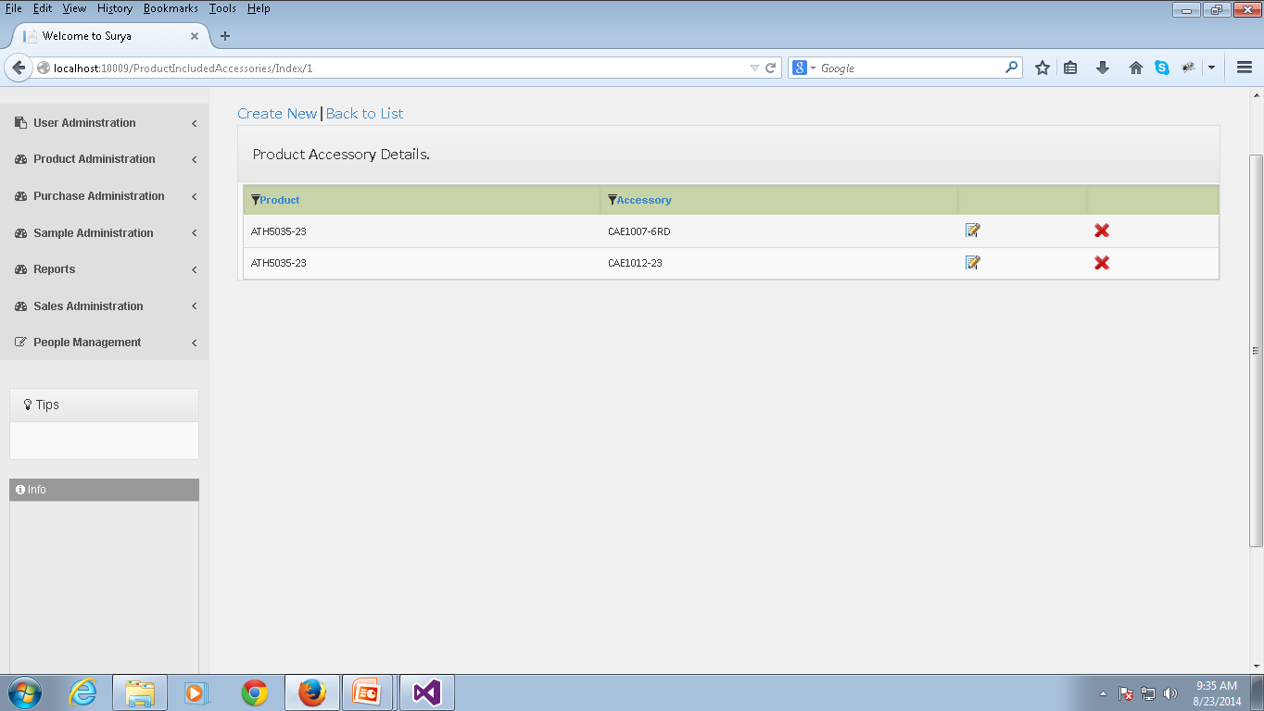
Included Accessories
Included Accessories | This page keeps all the information about the Included accessories to a particular product.
Permission | Action | Narration | Roles
 | Create | You can create a new Accessory for the particular product. | Manager, Data Entry Operator, Admin.
 | Modify | You can make changes to the accessory information of the product by clicking the corresponding modify icon. | Manager, Data Entry Operator, Admin.
 | Delete | You can delete the Accessory of the product by clicking the corresponding icon. | Manager, Data Entry Operator, Admin.

Slide 10
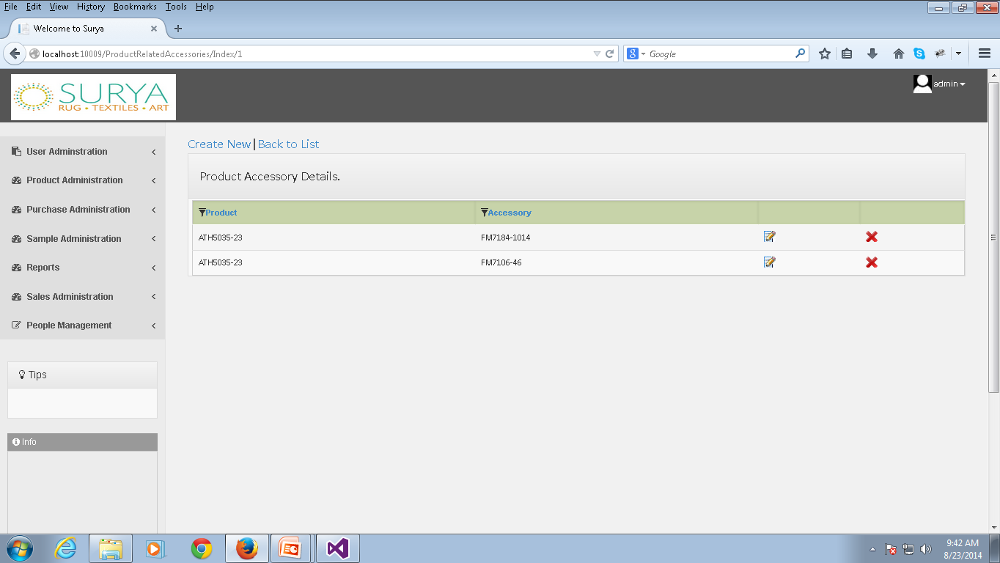
Related Accessory
Related Accessories | This page keeps all the information about all the related accessories for a particular product.
Permission | Action | Narration | Roles
 | Create | You can create a new related accessory for the particular product. | Manager, Data Entry Operator, Admin.
 | Modify | You can make changes to the accessory information of the product by clicking the corresponding modify icon. | Manager, Data Entry Operator, Admin.
 | Delete | You can delete the Accessory of the product by clicking the corresponding icon. | Manager, Data Entry Operator, Admin.

Slide 11
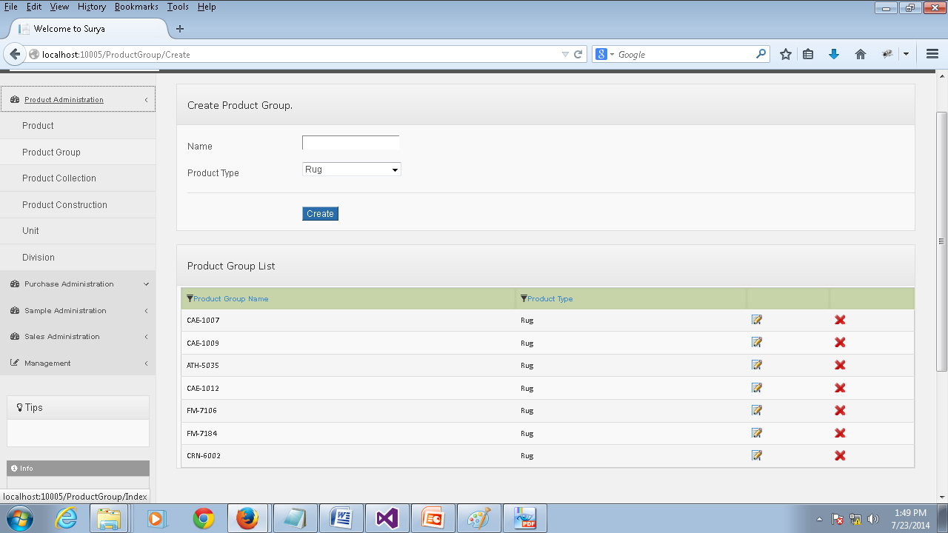
Create Product Group
Product Group | This page keeps information about each product group used in our business.
Permission | Action | Narration | Roles
 | Create | You can create a new product group using this link after filling the name and product type field. | Admin, Data Entry Operator
 | Modify | You can make changes to the product group information by clicking the corresponding modify icon. | Admin, Data Entry Operator.
 | Delete | You can delete a product group by clicking this link. | Admin.

Slide 12
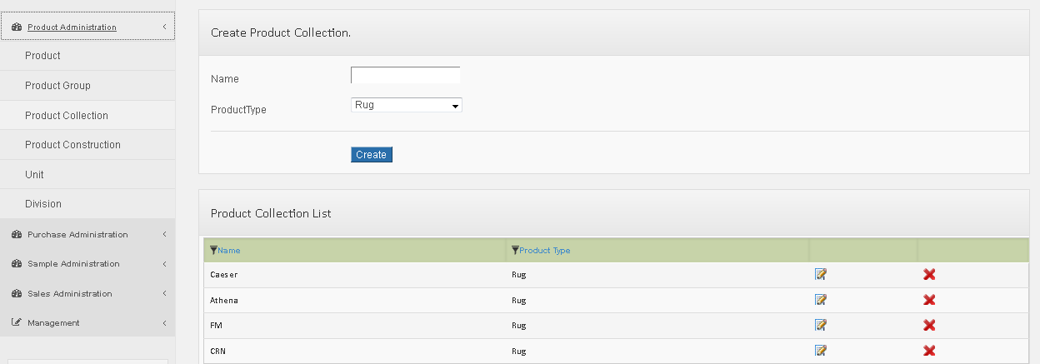
Create Product Collection
Product Collection | This page keeps information about each product collection used in our business.
Permission | Action | Narration | Roles
 | Create | You can create a new product collection using this link after filling the name field and selecting the product type field. | Admin, Data Entry Operator.
 | Modify | You can make changes to the product collection information by clicking the corresponding modify icon. | Admin, Data Entry Operator
 | Delete | You can delete a product collection by clicking this link. | Admin.

Slide 13
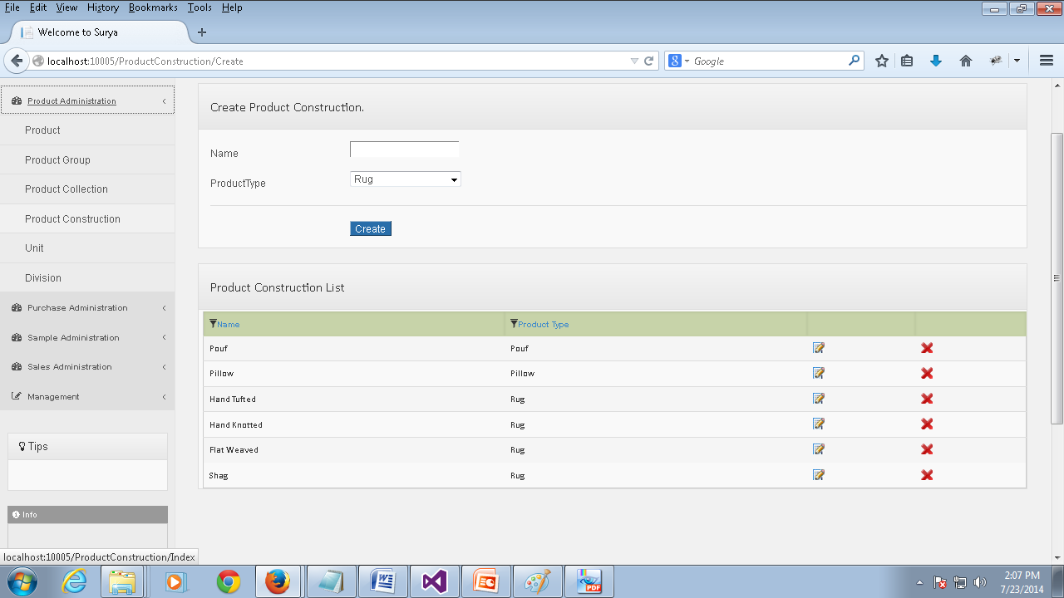
Create Product Construction
Product Construction | This page keeps information about product constructions used in our business.
Permission | Action | Narration | Roles
 | Create | You can create a new product construction using this link after filling the name field and choosing a product type field. | Admin, Data Entry Operator.
 | Modify | You can make changes to the product construction information by clicking the corresponding modify icon. | Admin, Data Entry Operator
 | Delete | You can delete a product construction by clicking this link. | Admin.

Slide 14
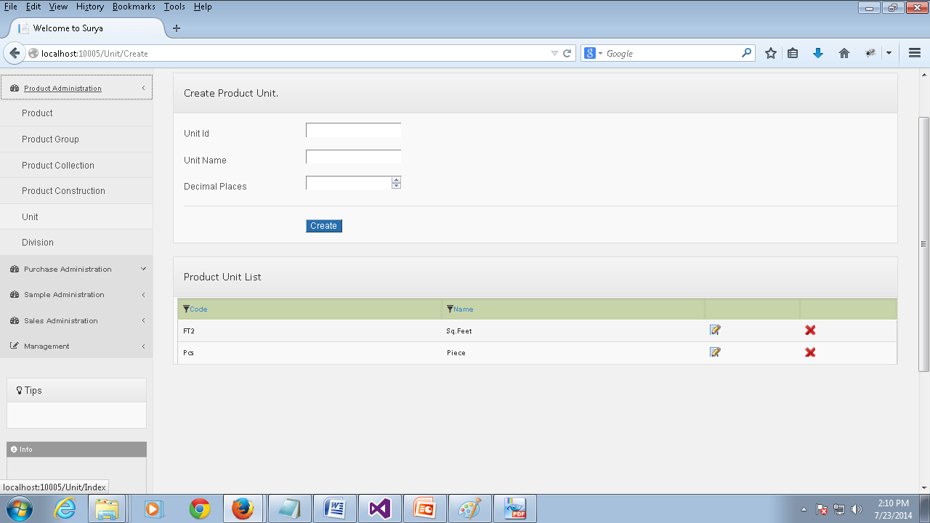
Create Product Unit
Unit | This page keeps information about Unit types used in our business.
Permission | Action | Narration | Roles
 | Create | You can create a new Unit using this link after filling the unit id, unit name and Decimal places field. | Admin.
 | Modify | You can make changes to the unit information by clicking the corresponding modify icon. | Admin.
 | Delete | You can delete a unit by clicking this link. | Admin.

Slide 15
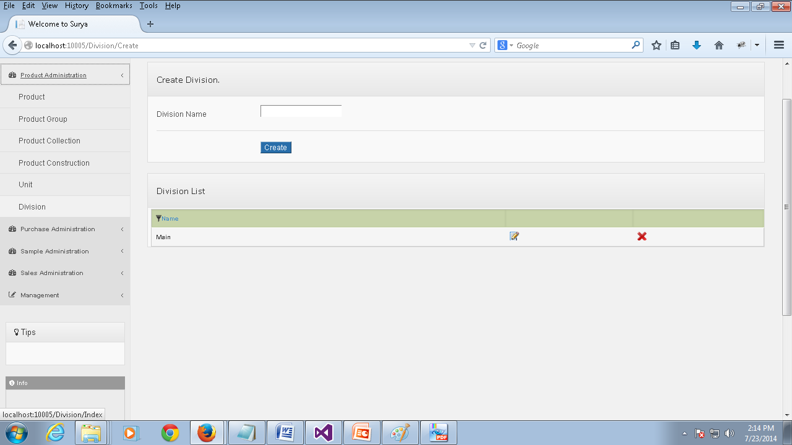
Create Division
Division | This page keeps information about Divisions in our business.
Permission | Action | Narration | Roles
 | Create | You can create a new division using this link after filling the division name field. | Admin.
 | Modify | You can make changes to the division information by clicking the corresponding modify icon. | Admin.
 | Delete | You can delete a division by clicking this link. | Admin.

Slide 16
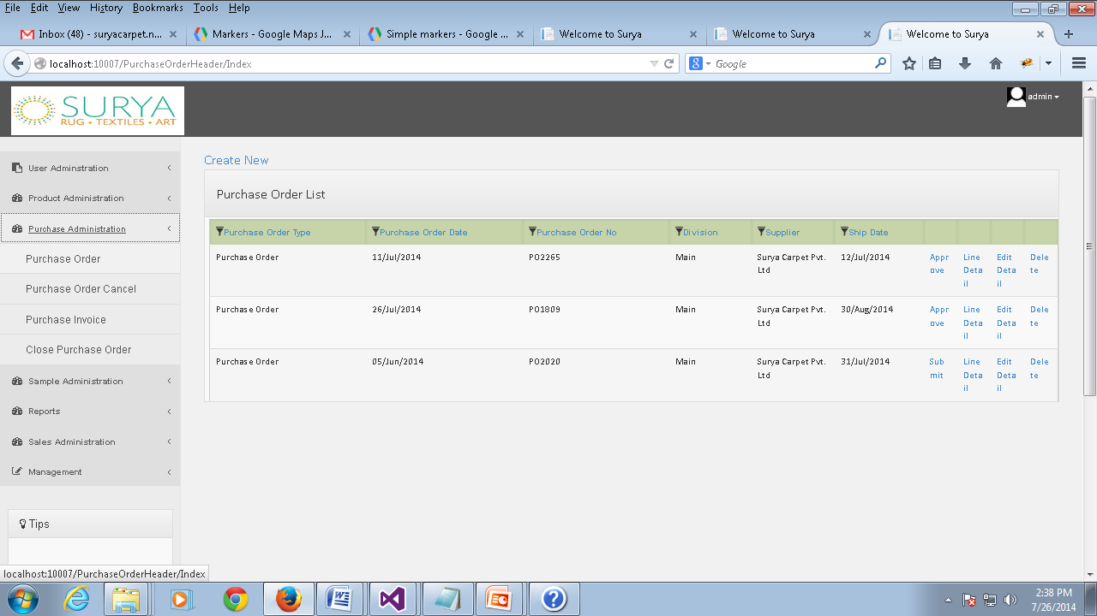
Purchase Order List
Purchase Order | This page keeps information about purchase orders lists in our business.
Permission | Action | Narration | Roles
 | Create | You can create a new purchase order using this link.(which will be shown in the next slide) | Admin, Data Entry Operator.
 | Modify | You can make changes to the purchase order information by clicking the corresponding Edit link. | Admin, Manager, Data Entry Operator.
 | Delete | You can delete a purchase order by clicking this link. | Admin.
 | Line Detail | You can view the line detail information about the corresponding purchase order using this link.(which will be shown in the slide next to the create slide.) | Admin, Data Entry Operator, Manager.
 | Detail | You can view the details of the corresponding purchase order using this link.(which will be shown next to line detail and the Create line detail slide) | Admin, Data Entry Operator, Manager.
 | Submit | You can submit a purchase order using this link. | Data Entry Operator, Admin
 | Approve | You can approve the particular purchase order using this link. | Admin, Manager.
 | Confirm | You can confirm the purchase order by clicking this option. | Supplier.

Slide 17
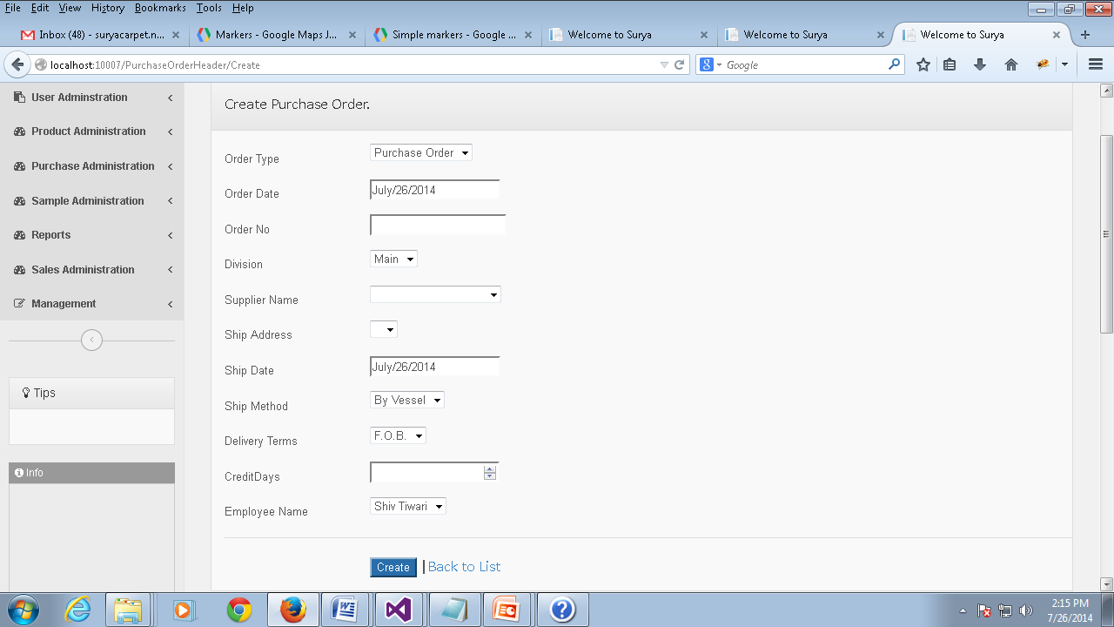
Create Purchase Order
Field Name | Narration | Field Name | Narration
Order Type | Defines the type of the order | Ship Date | The date before which the products is to be shipped.
Order Date | Specifies the date on which the order is made | Ship Method | Defines the mode of shipment
Order No | Unique number for identifying the order | Delivery Terms | Defines the delivery terms
Division | Specifies the division from where the order is made. | Credit Days | Specifies the number of credit days for the supplier.
Supplier Name | Name of the supplier for the product | Employee Name | Name of the employee who is creating the purchase order.
Ship Address | The address of the supplier where the order is placed.

Slide 18
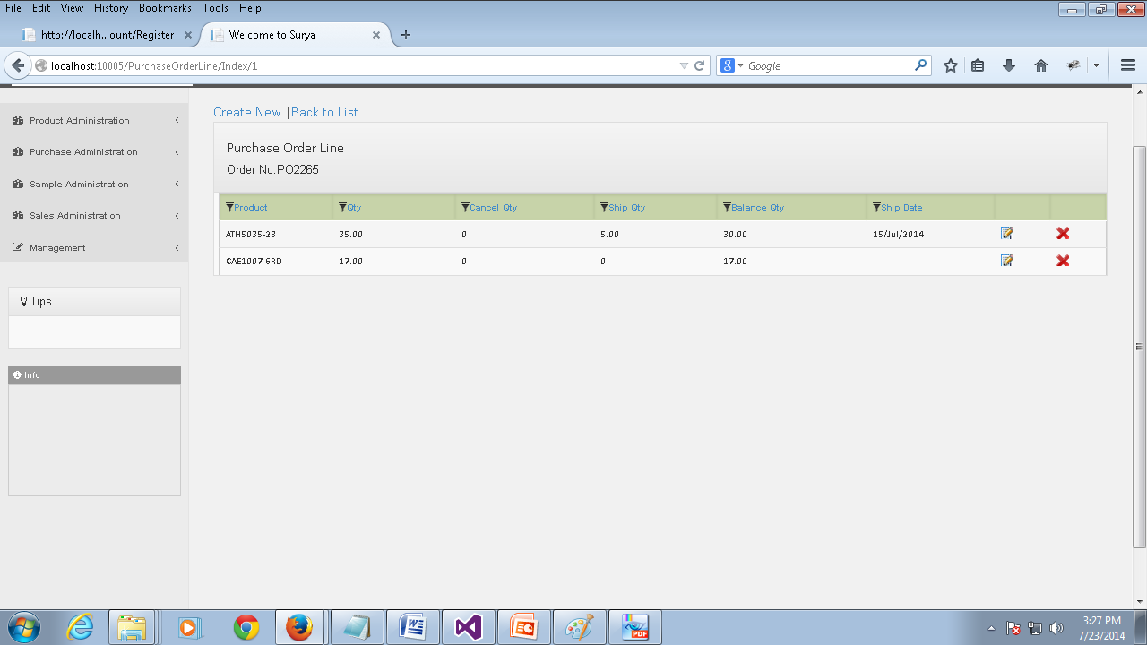
Purchase Order Line
Purchase Order Line. | This page keeps information about purchase order lines of a particular purchase order .
Permission | Action | Narration | Roles
 | Create | You can create a new purchase order line using this link which is found at the top of the section. | Admin., Data Entry Operator
 | Modify | You can make changes to the purchase order line information by clicking the corresponding modify icon. | Admin., Manager, Data Entry Operator.
 | Delete | You can delete a purchase order line by clicking this link. | Admin, Manager.

Slide 19
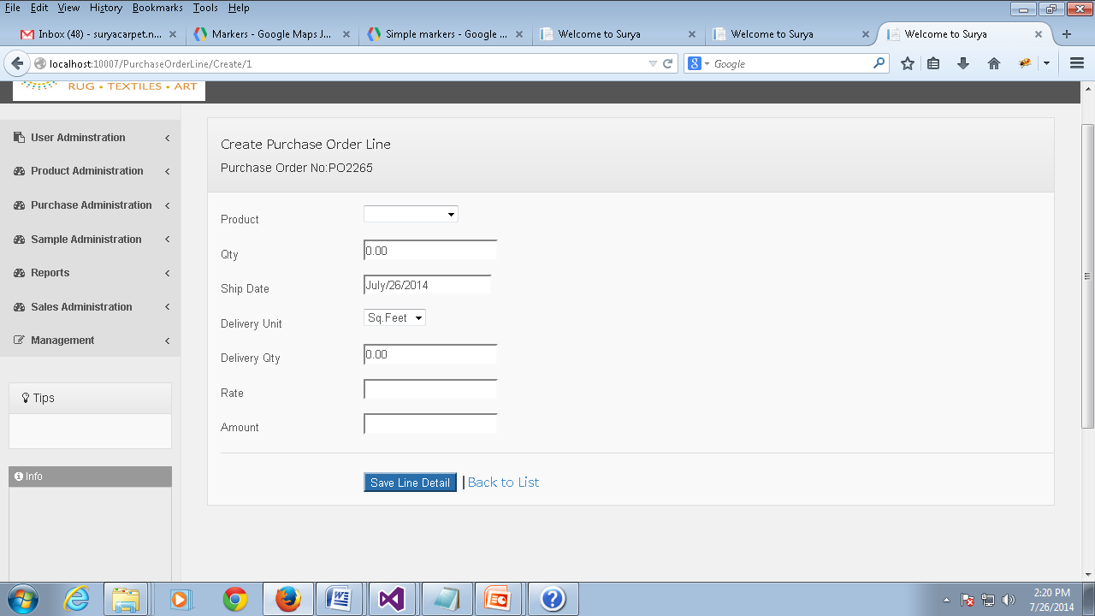
Create Purchase Order Line
Field Name | Narration | Field Name | Narration
Product | Specifies the product type using a unique ID | Delivery Qty | Specifies the number of quantities to be delivered
Qty | Specifies number of quantities as per requirement | Rate | Defines the price of the product
Ship Date | Defines the date before which the product should be shipped | Amount | Specifies the amount based on the rate of the product and the delivery unit.
Delivery Unit | Defines the unit type of the product delivery

Slide 20
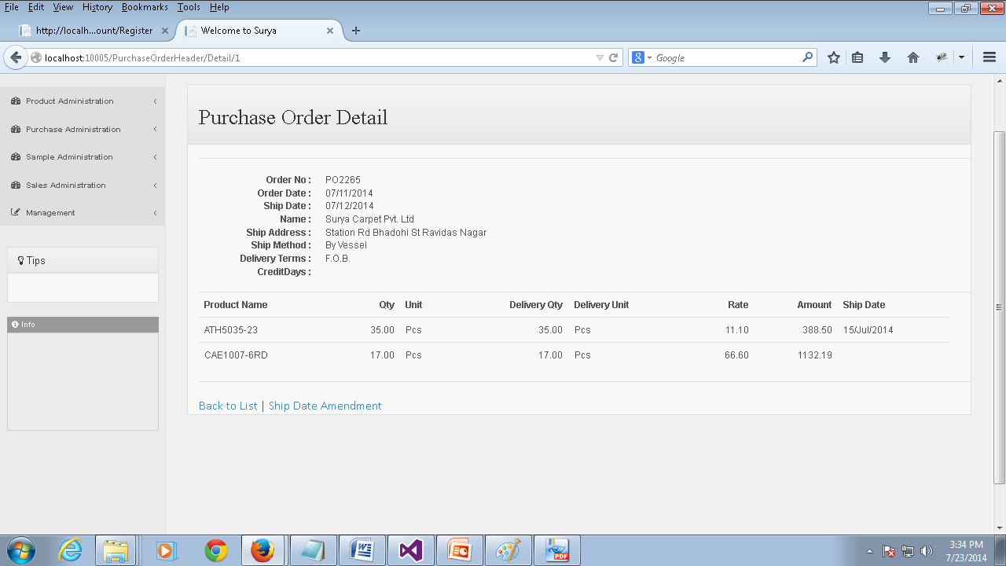
Purchase Order Detail
Purchase Order Detail. | This page keeps information about details of a particular purchase order.
Permission | Action | Narration | Roles
 | Ship Date Amendment. | You can make changes to the ship date for a purchase order using this link. | Admin, Manager.

Slide 21
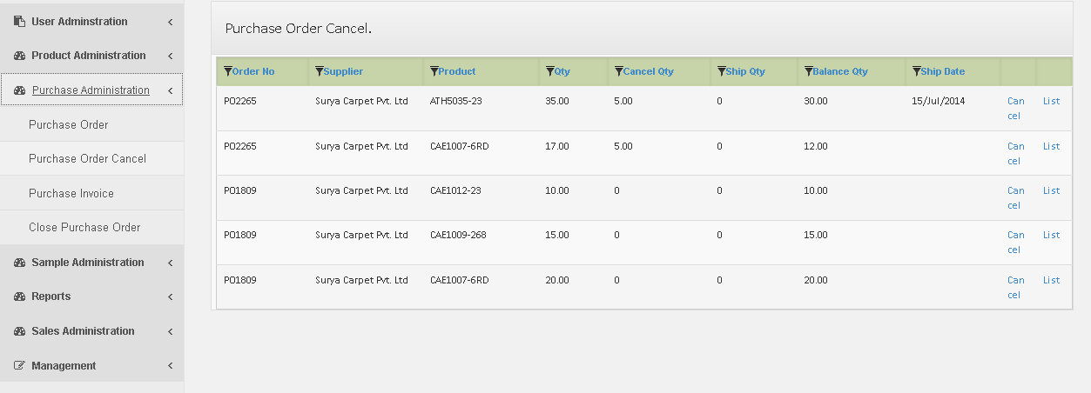
Purchase Order Cancel
Purchase order cancel | This page keeps information about purchase order cancel quantities.
Permission | Action | Narration | Roles
 | Cancel | You can cancel a particular product for any purchase order | Admin, Data Entry Operator, Manager
 | List | You can view the list of cancelled items from a purchase order using this link.(which will be shown in the next slide) | Admin.

Slide 22
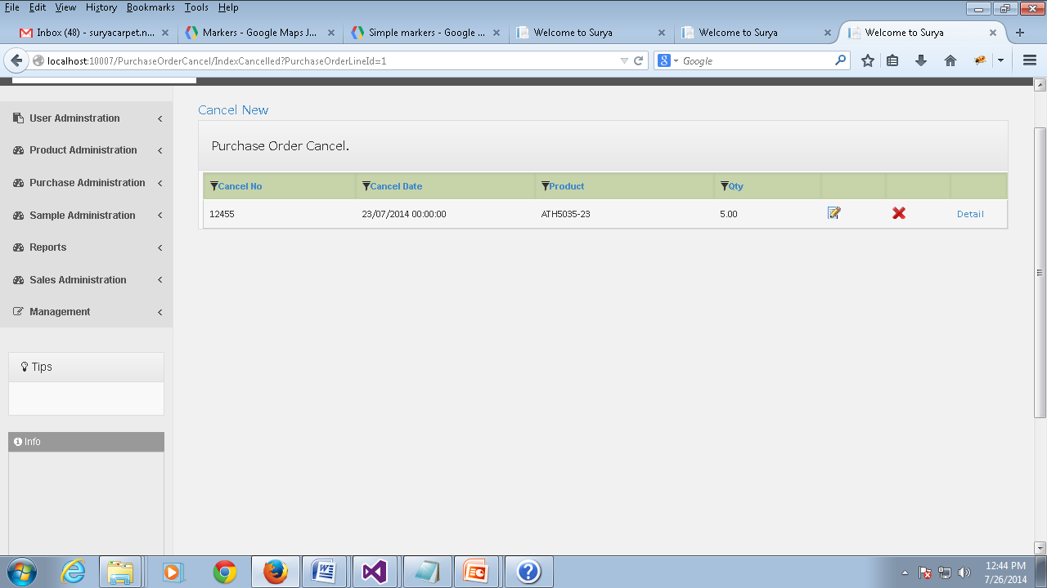
Purchase Order Cancel
Purchase order cancel List | This page keeps information about the list of cancelled items from a purchase order.
Permission | Action | Narration | Roles
 | Cancel New | You can cancel a particular product for any purchase order | Admin., Data Entry Operator.
 | Modify | You can make changes to the cancelled purchase order items | Admin, Manager, Data Entry Operator.
 | Delete | You can delete a purchase order cancel list using this link | Admin.

Slide 23
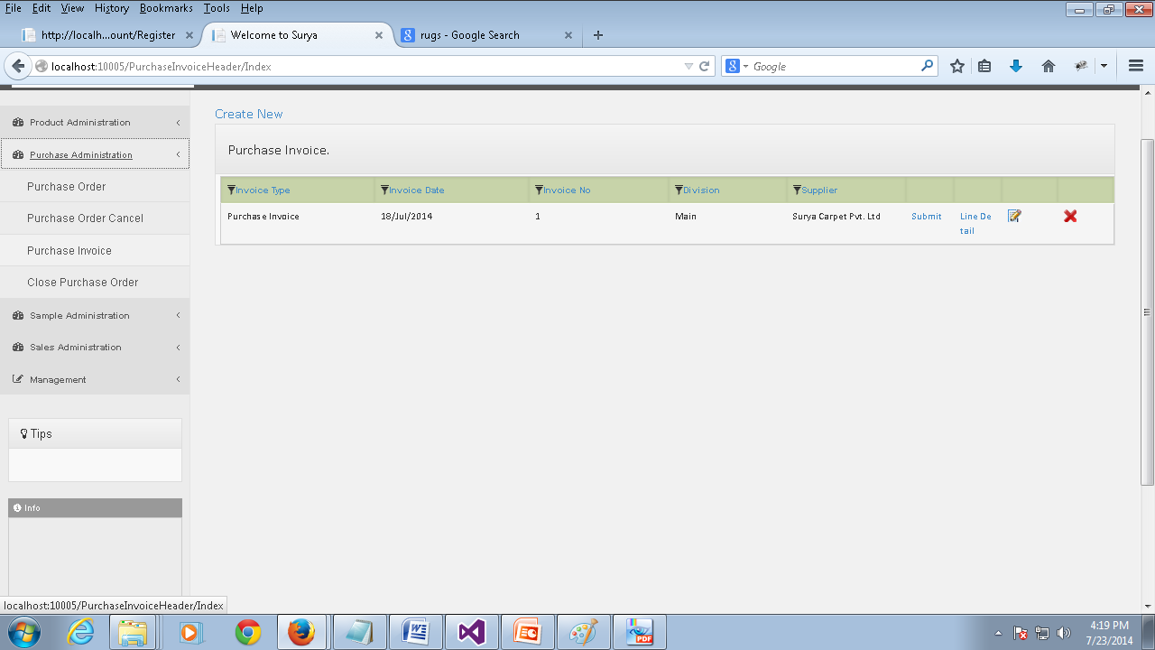
Purchase Invoice
Purchase Invoice | This page keeps information about purchase invoices.
Permission | Action | Narration | Roles
 | Create | You can create a new purchase invoice using this link which is found at the top of the section.(which will be shown in the next slide) | Admin, Data Entry Operator.
 | Modify | You can make changes to the purchase invoice information by clicking the corresponding modify icon. | Admin, Manager, Data Entry Operator.
 | Delete | You can delete a purchase invoice by clicking this link. | Admin.
 | Line Detail | You can view the line detail information of a particular purchase invoice by clicking this link(which will be shown next to the create slide) | Admin, Data Entry Operator, Manager.
 | Submit | You can submit the purchase invoice using this link. | Admin, Data Entry Operator.
 | Approve | You can approve the Purchase invoice using this link. | Admin, Manager.

Slide 24
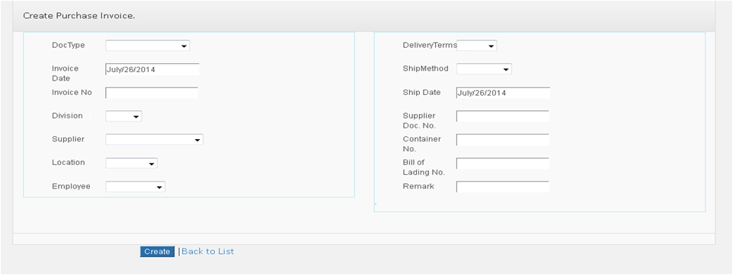
Create Purchase Invoice
Field Name | Narration | Field Name | Narration
Doc Type | Defines the type of the document | Ship Method | The shipping method information should be specified here
Invoice Date | Specifies the date on which the invoice is created. | Ship Date | The date before which the delivery should be done is specified here
Division | Specifies the division of the company | Supplier Doc No | Specifies the document numbers of the supplier
Supplier | The supplier name should be entered here | Container No | The container information should be specified here.
Location | The location information from where goods are dispatched should be specified here | Bill of Lading No | The lading number information should be provided here
Delivery Terms | Specifies the delivery terms . | Remark | This section can be used to specify any remarks.

Slide 25
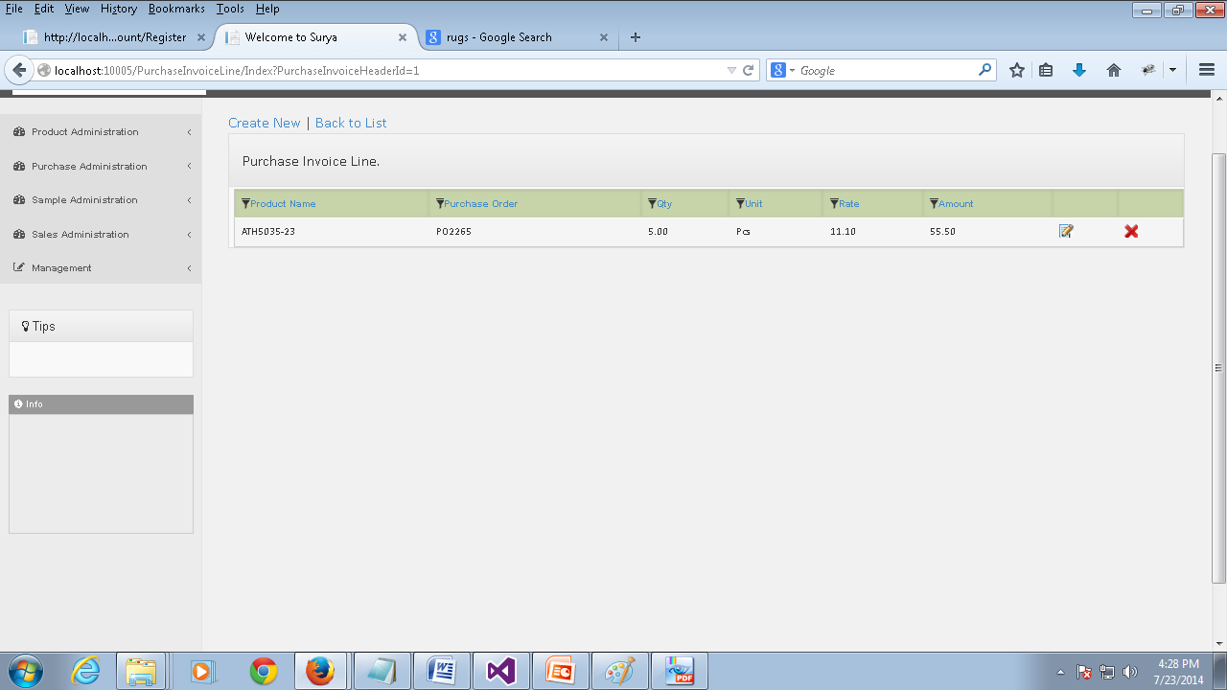
Purchase Invoice Line
Purchase Invoice Line | This page keeps information about the purchase invoice line details for a particular purchase invoice.
Permission | Action | Narration | Roles
 | Create | You can create a new purchase invoice line using this link which is found at the top of the section. | Admin, Data Entry Operator.
 | Modify | You can make changes to the purchase invoice line information by clicking the corresponding modify icon. | Admin, Data Entry Operator, Manager.
 | Delete | You can delete a purchase invoice line by clicking this link. | Admin., Data Entry Operator.

Slide 26
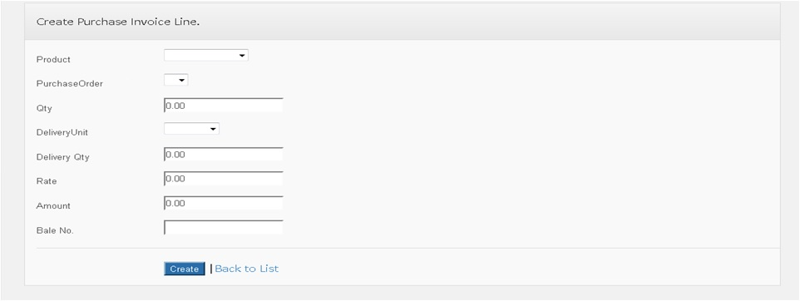
Create Purchase Invoice Line
Field Name | Narration | Field Name | Narration
Product | Specifies a unique series of numbers which represents the product | Delivery Qty | The number of quantities delivered should be specified here
Purchase Order | The purchase order information for which the purchase invoice is created should be specified here | Rate | The rate of the product should be specified here
Qty | The number of quantities for which the invoice is made | Amount | The amount for the product based of the rate and quantity is specified here
Delivery Unit | The unit type for which the delivery is made | Bale No. | The bale number information should be specified in this section.

Slide 27
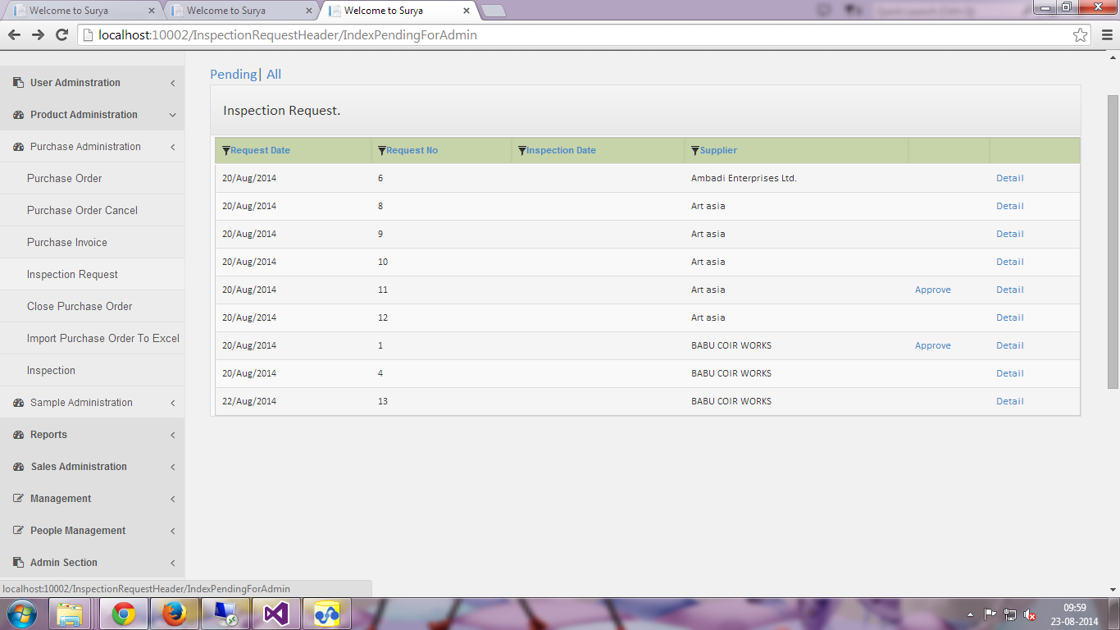
Inspection Request
Inspection Request | This page shows all the inspection requests done created by the supplier. You can view the pending or all the inspection request documents by clicking the corresponding links.
Permission | Action | Narration | Roles
 | Approve | You can approve the inspection request by using this link. | Inspection Manager, Admin
 | Details | You can use this link to view the complete details of the inspection request. | Manager, Inspection Manager, Data Entry Operator, Admin.

Slide 28
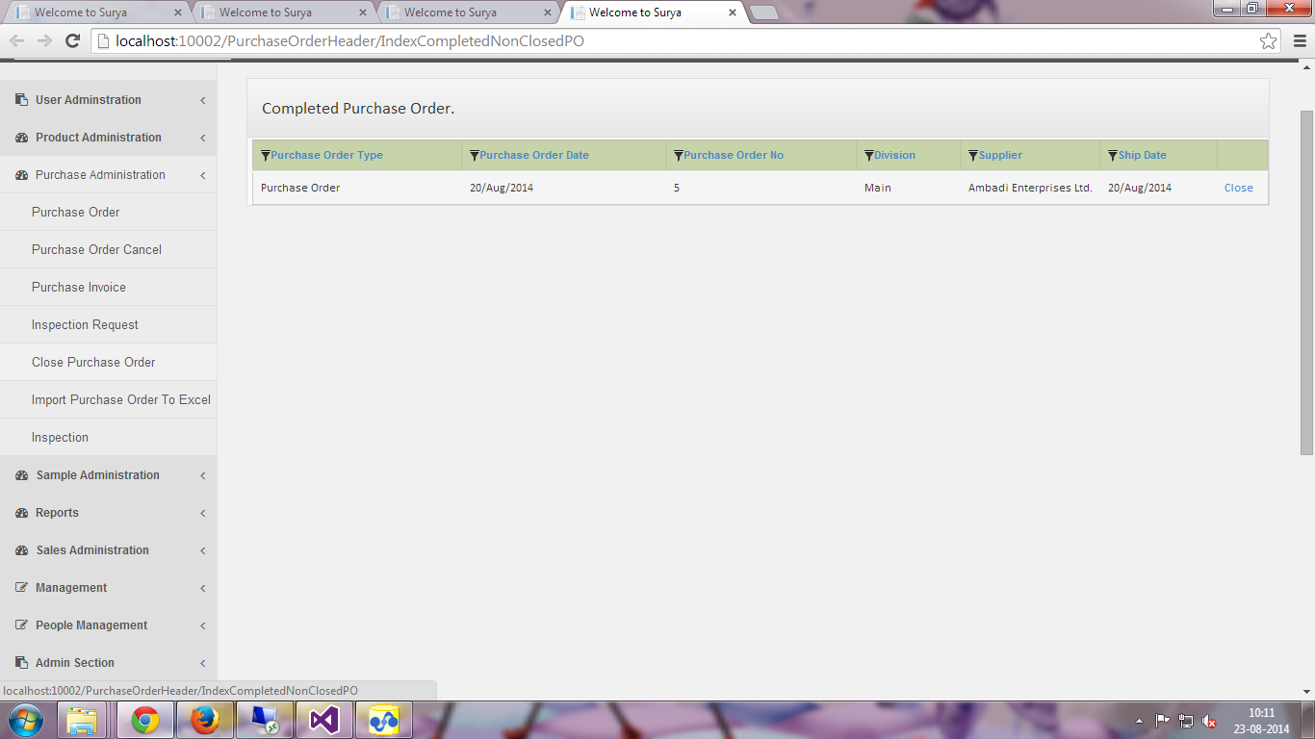
Completed Purchase Order
Close Purchase Order | This page keeps information about the purchase orders of which all the products are shipped and not yet closed.
Permission | Action | Narration | Roles
 | Close | You can close the purchase order when all the products are shipped. | Admin, Manager.

Slide 29
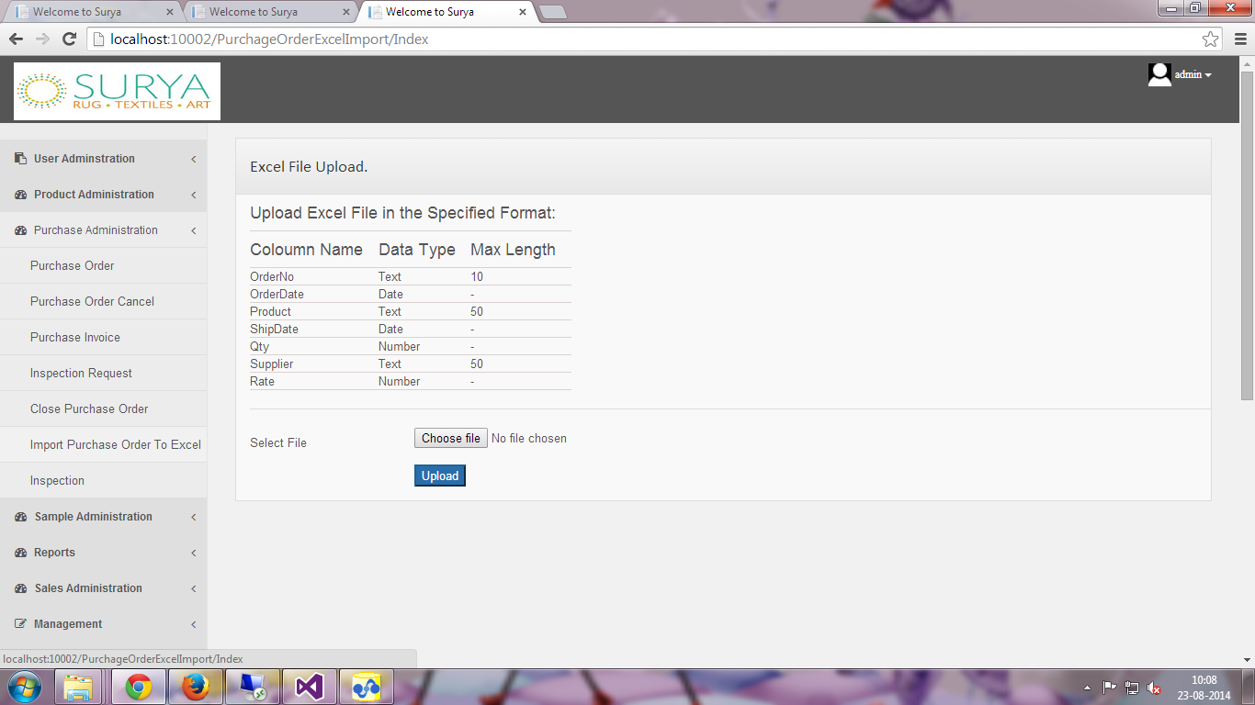
Import Purchase Order from Excel
Import Purchase Order | You can import the purchase orders from an Excel file using this page.
Permission | Action | Narration | Roles
 | Upload | Once you have chose the Excel file using the Choose File button you can click the upload button to upload the purchase orders from excel file. Please note to follow the specified format while creating the excel file. | Data Entry Operator, Admin, Manager.

Slide 30
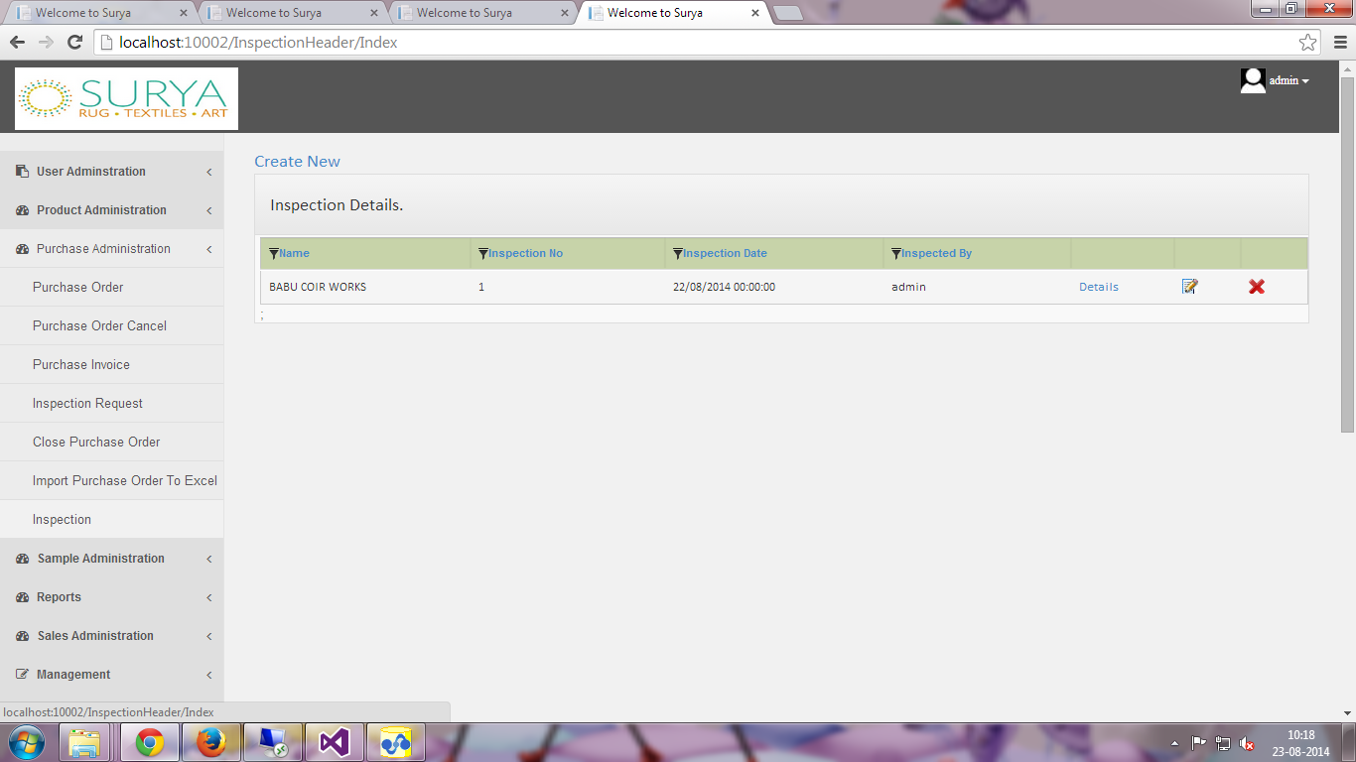
Inspection Details
Inspection | You can view the inspection details using this page. This page contains the list of documents on which the inspection is completed.
Permission | Action | Narration | Roles
 | Create | You can create a new inspection by choosing a inspection request by clicking this link(You can find more information about this in the next slide) | Inspection Manager, Manager, Data Entry Operator, Admin.
 | Details | You can view the details of the inspection by clicking this link. | Inspection Manager, Manager, Data Entry Operator, Admin.
 | Modify | You can modify the Inspection details clicking the corresponding icon. | Inspection Manager, Admin
 | Delete | You can delete the corresponding inspection information by using this link. | Admin

Slide 31
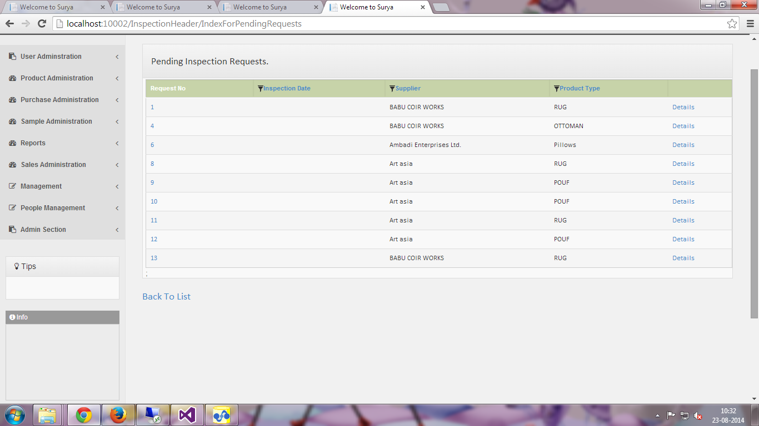
Create Inspection
Create Inspection | Once you click the create new inspection link you will be redirected to this page which consists of all the pending inspection requests.
Permission | Action | Narration | Roles
 | Request No | To create a new inspection for any inspection request you have to click the corresponding Request No(More details about creating new inspection will be shown in the next slide) | Inspection Manager, Admin
 | Details | Clicking this link will show all the details of the corresponding Inspection requests. | Inspection Manager, Manager, Data Entry Operator, Admin.

Slide 32
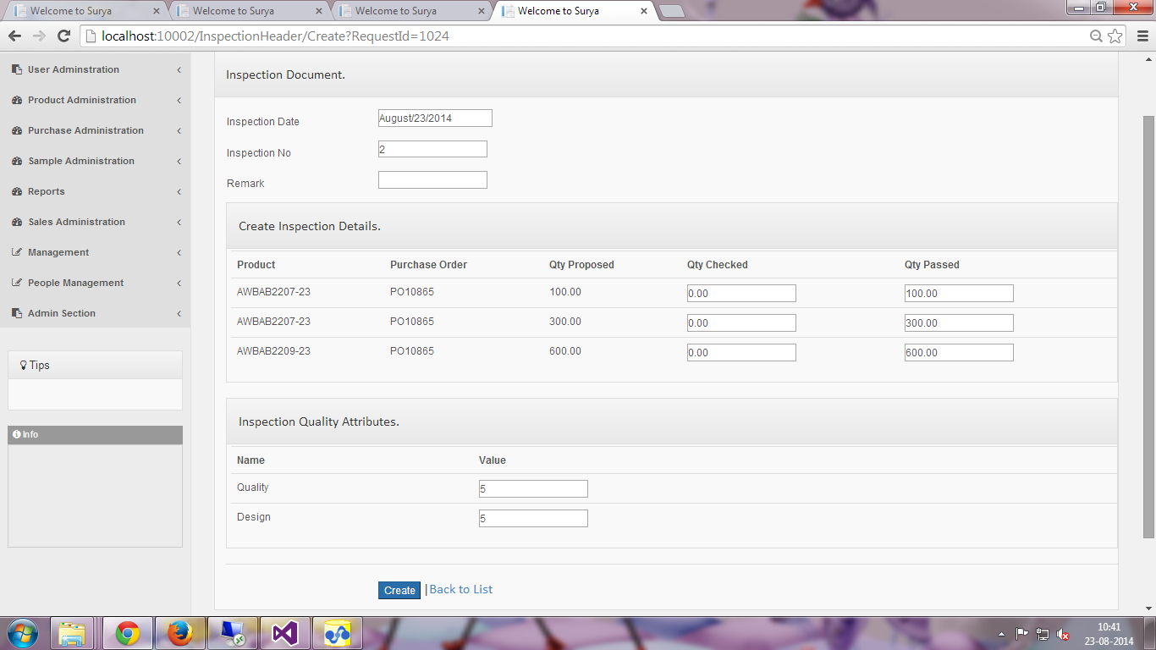
Create Inspection
Field Name | Narration | Field Name | Narration
Inspection Date | This shows the date on which the inspection is made. | Qty Passed | This field is used to enter the total number of quantities passed for inspection.
Inspection No | This is the Unique number which is used to keep track of the inspections. | Inspection Quality Attributes | This category consists of all the quality attributes of the particular product type. You can enter the values for the corresponding quality attribute with in the rating scale of 1-5.
Remark | You can specify the remarks if there are any.
Qty Checked | This field is used to enter the number of pieces checked for inspection.

Slide 33
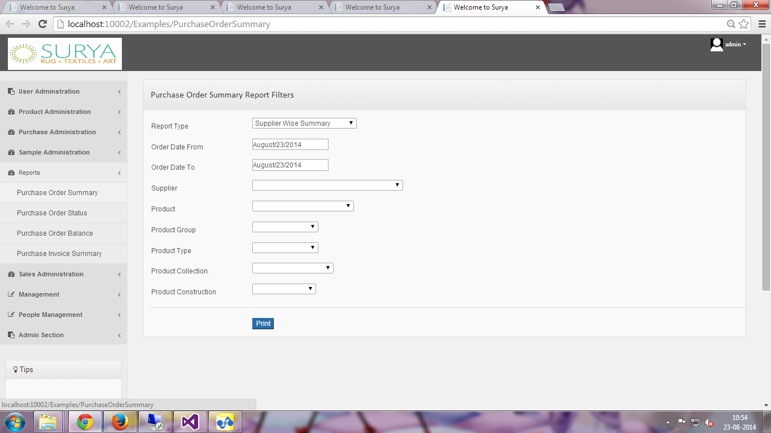
Purchase Order Summary Report
Field Name | Narration | Field Name | Narration
Report Type | You can choose the type of the report using this field | Product Group | This field specifies the Product Group information for which you want to generate a report.
Order Date From | This field specifies the date from which you want to generate the report. | Product Type | This field specifies the product type for which you want to generate a report.
Order Date To | This field specifies the date to which you want to generate the report. | Product Collection | This field specifies the product collection information for which you want to generate a report
Supplier | This field specifies the supplier name | Product Construction | This field shows the product construction information for which you want to generate a report.
Product | This field specifies the product for which you want to generate a report.

Slide 34
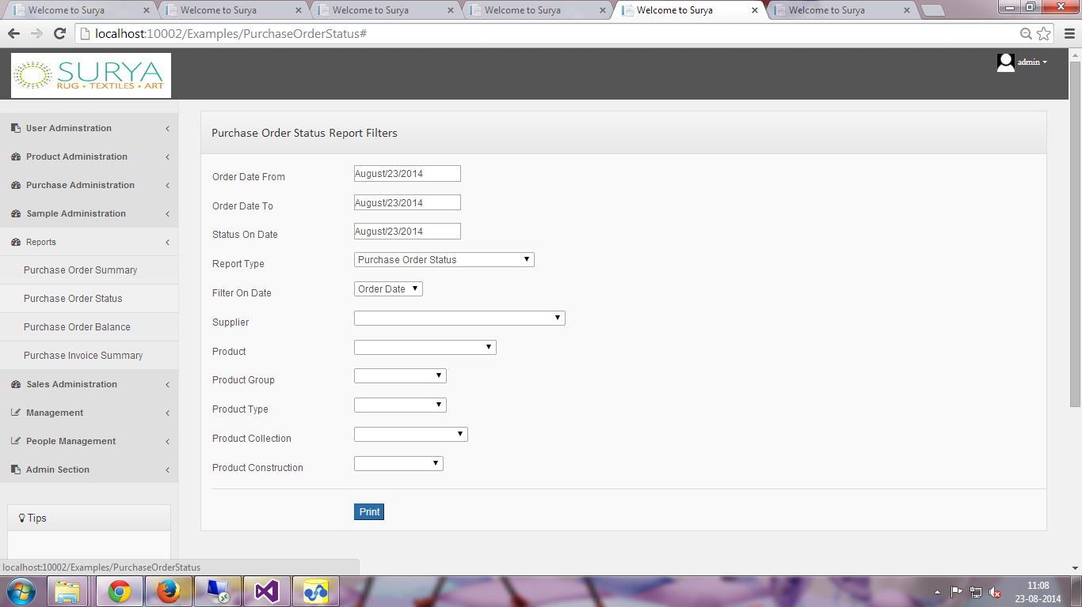
Purchase Order Status Report
Field Name | Narration | Field Name | Narration
Order Date From | This field specifies the date from which you want to generate the report. | Product | This field specifies the product for which you want to generate a report.
Order Date To | This field specifies the date to which you want to generate the report. | Product Group | This field specifies the Product Group information for which you want to generate a report.
Status On Date | This specifies the date on which you want to know the status of the product. | Product Type | This field specifies the product type for which you want to generate a report.
Report Type | This specifies the type of the report you would like to generate. | Product Collection | This field specifies the product collection information for which you want to generate a report
Supplier | This field allows you to select the supplier name. | Product Construction | This field shows the product construction information for which you want to generate a report.

Slide 35
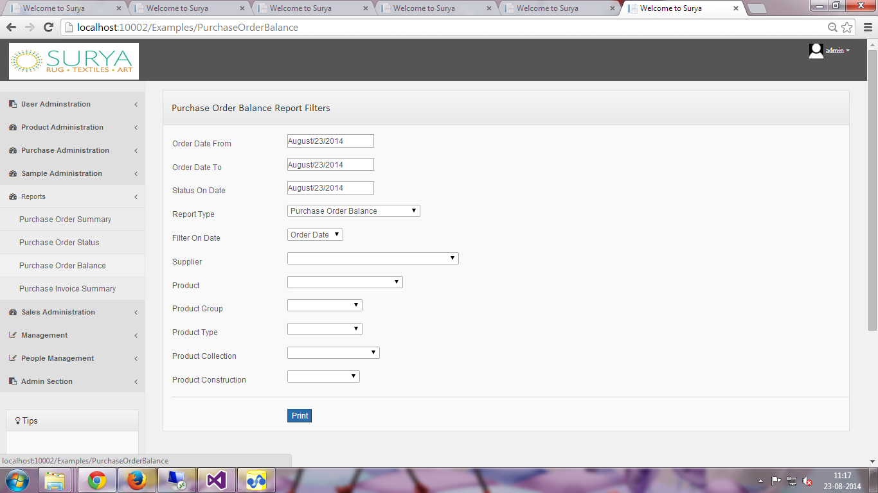
Purchase Order Balance Reports
Field Name | Narration | Field Name | Narration
Order Date From | This field specifies the date from which you want to generate the report. | Product | This field specifies the product for which you want to generate a report.
Order Date To | This field specifies the date to which you want to generate the report. | Product Group | This field specifies the Product Group information for which you want to generate a report.
Status On Date | This specifies the date on which you want to know the status of the product. | Product Type | This field specifies the product type for which you want to generate a report.
Report Type | This specifies the type of the report you would like to generate. | Product Collection | This field specifies the product collection information for which you want to generate a report
Filter On Date | This field allows you to select based on the order date or ship date. | Product Construction | This field shows the product construction information for which you want to generate a report.
Supplier | This field allows you to select the supplier name.

Slide 36
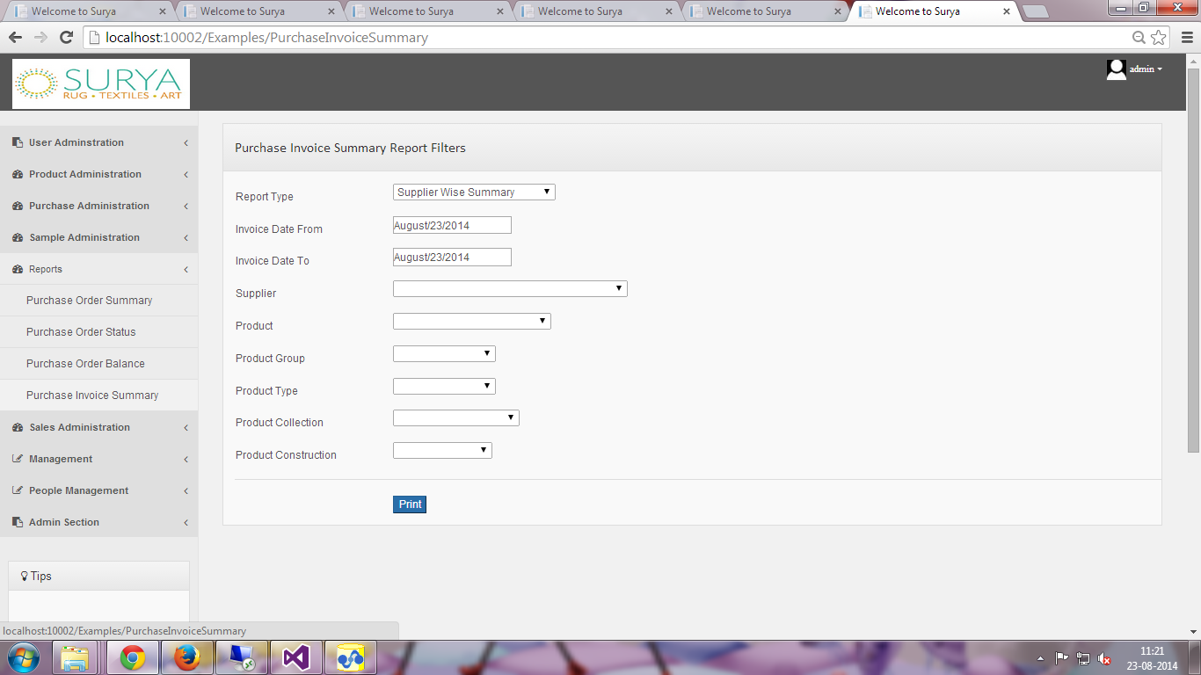
Purchase Invoice Summary
Field Name | Narration | Field Name | Narration
Report Type | This field allows you to specify the type of the report you would like to generate | Product | This field specifies the product for which you want to generate a report.
Invoice Date From | This specifies the date from when the invoices were made. | Product Group | This field specifies the Product Group information for which you want to generate a report.
Invoice Date To | This specifies the to date until which the report is to be generated. | Product Type | This field specifies the product type for which you want to generate a report.
Supplier | This field allows you to specify the supplier name for whom you want to generate a report. | Product Collection | This field specifies the product collection information for which you want to generate a report
 |  | Product Construction | This field shows the product construction information for which you want to generate a report.

Slide 37
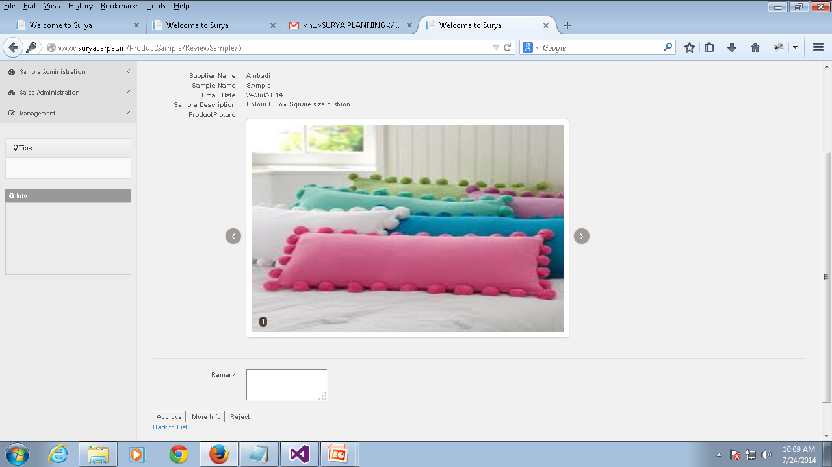
Sample Review
Sample Review | This page keeps information about the product samples added by the supplier. Manager can reject/approve or request for more information on a particular product. The corresponding Manager will be receiving a email along with a link to review the product when supplier adds a new sample.
Permission | Action | Narration | Roles
 | Approve | You can approve the product by clicking this link | Admin, Manager.
 | More Info | You can request for more information about the product by clicking this link and adding remarks to the field | Admin, Manager.
 | Reject | You can reject the product sample if it does not meet the quality requirements | Admin., Manager.

Slide 38
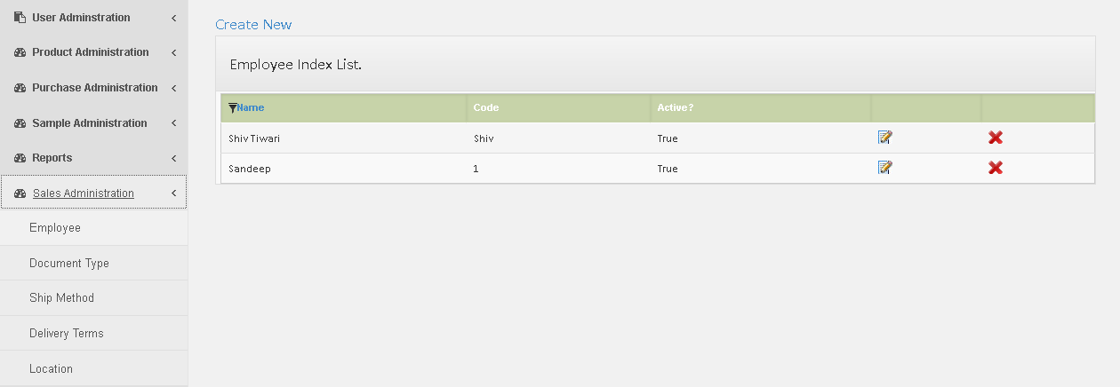
Employee Index List
Employee | This page keeps information about Employee list in our business.
Permission | Action | Narration | Roles
 | Create | You can create a new employee using this link. | Admin, Manager, Data Entry Operator.
 | Modify | You can make changes to the employee information by clicking the corresponding modify icon. | Admin, Manager, Data Entry Operator.
 | Delete | You can delete a employee by clicking this link. | Admin.

Slide 39
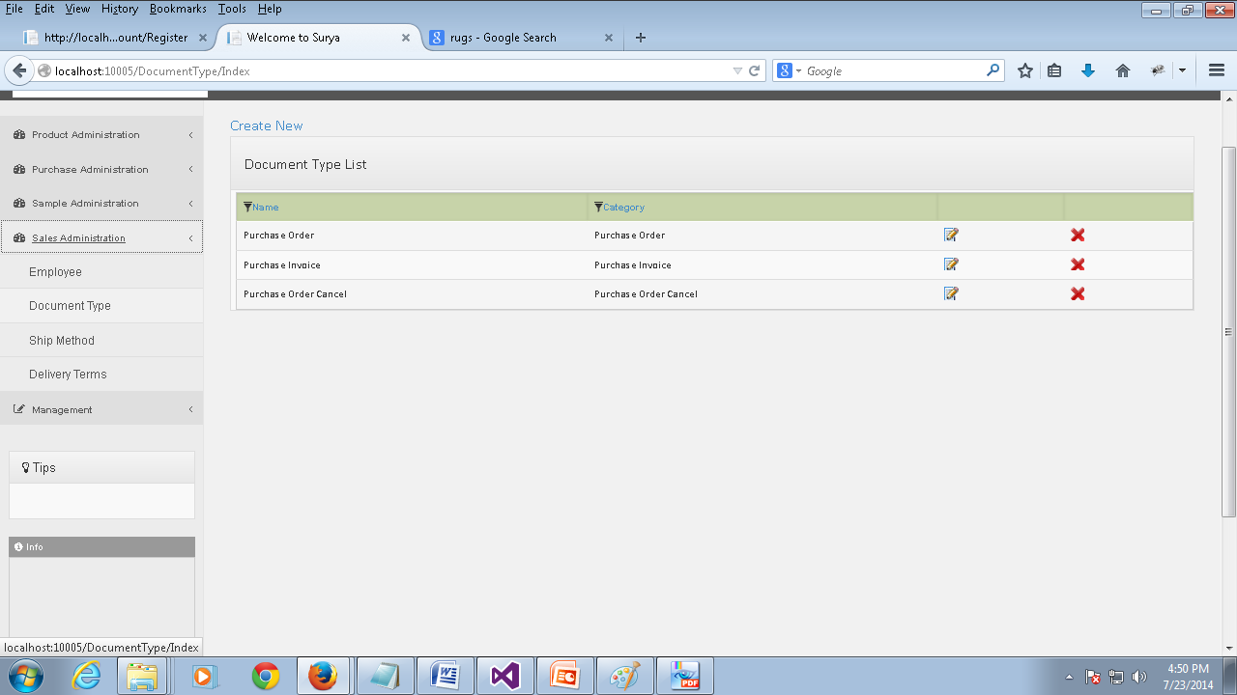
Document Type List
Document Type | This page keeps information about document types in our business.
Permission | Action | Narration | Roles
 | Create | You can create a new document type using this link which is found at the top of the section. | Admin.
 | Modify | You can make changes to the document type information by clicking the corresponding modify icon. | Admin.
 | Delete | You can delete a document type by clicking this link. | Admin.

Slide 40
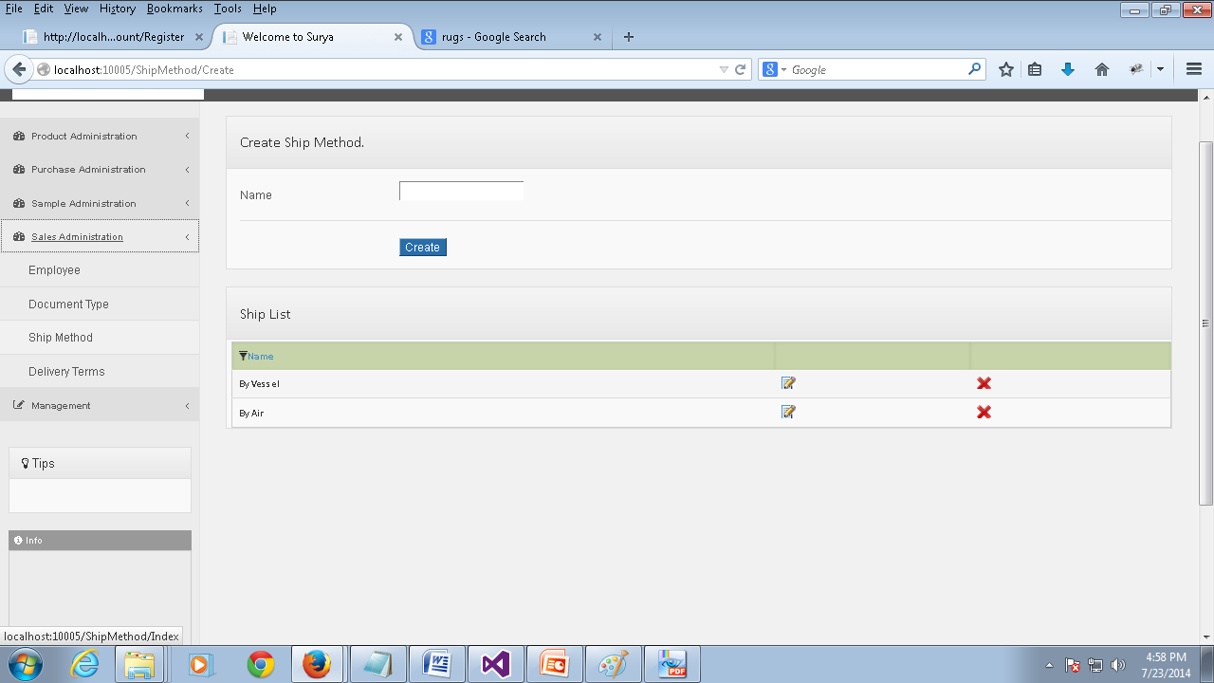
Create Ship Method
Ship Method | This page keeps information about shipping methods in our business.
Permission | Action | Narration | Roles
 | Create | You can create a new ship method using this link after filling the name field. | Admin.
 | Modify | You can make changes to the ship method information by clicking the corresponding modify icon. | Admin.
 | Delete | You can delete a ship method by clicking this link. | Admin.

Slide 41
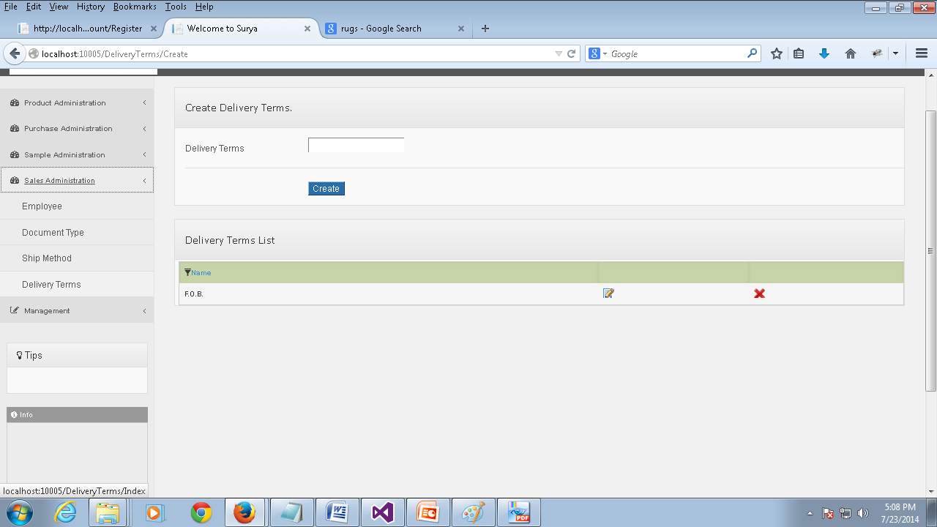
Create Delivery Terms
Delivery Terms | This page keeps information about Delivery terms in our business.
Permission | Action | Narration | Roles
 | Create | You can create new delivery terms using this link after filling the delivery terms field. | Admin.
 | Modify | You can make changes to the delivery terms information by clicking the corresponding modify icon. | Admin.
 | Delete | You can delete a delivery term by clicking this link. | Admin.

Slide 42
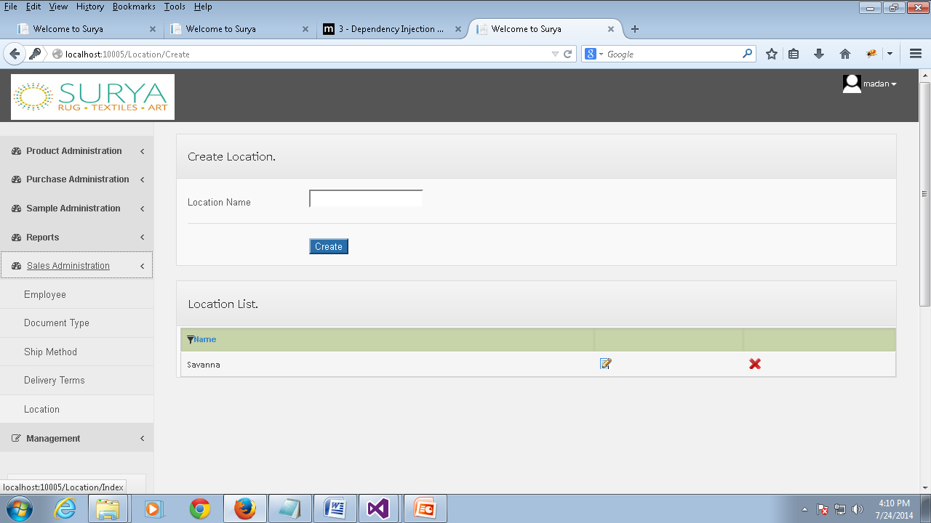
Create Location
Location | This page keeps information about location list in our business.
Permission | Action | Narration | Roles
 | Create | You can create a new location using this link after filling the location name field. | Admin.
 | Modify | You can make changes to the location information by clicking the corresponding modify icon. | Admin.
 | Delete | You can delete a location by clicking this link. | Admin.

Slide 43
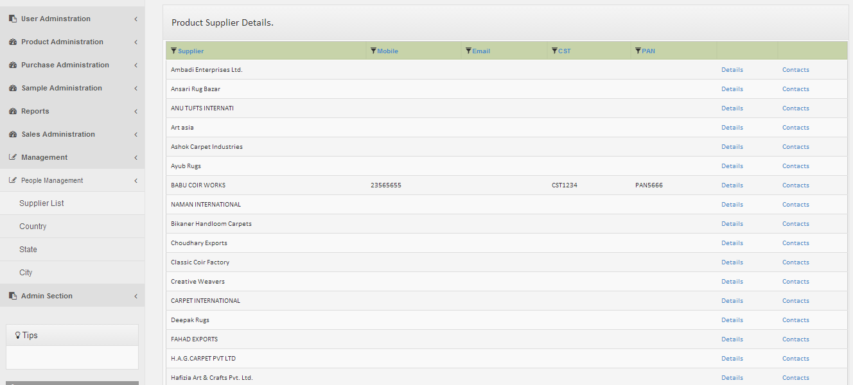
Supplier List
Supplier List | This page shows the list of information of the product suppliers. You can access this page under the People Management category from the Supplier List tab.
Permission | Action | Narration | Roles
 | Details | You can view the details of the supplier by clicking this link. | Inspection Manager, Manager, Data Entry Operator, Admin.
 | Contacts | You can view all the contact information of the supplier by clicking this link(you can find out more about this in the next slide) | Inspection Manager, Manager, Data Entry Operator, Admin.

Slide 44
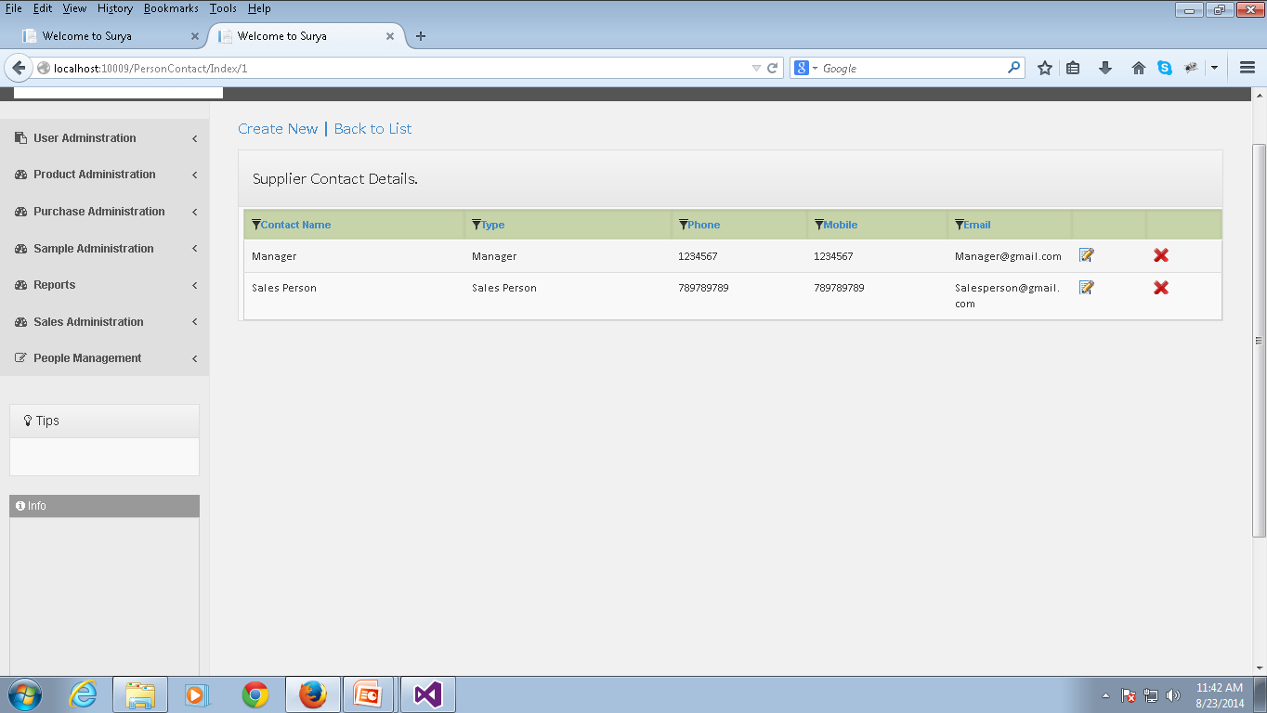
Supplier Contact Details
Supplier Contact Details | This page shows all the contact information of a particular supplier.
Permission | Action | Narration | Roles
 | Create | You can create a new supplier contact using this link. You can choose the Contact type, fill in the details of the supplier contact and click the save button to save the contact information. | Inspection Manager, Manager, Data Entry Operator, Admin.
 | Modify | You can edit the corresponding supplier contact information by clicking the modify icon. | Inspection Manager, Manager, Data Entry Operator, Admin.
 | Delete | You can delete the corresponding contact by clicking the corresponding icon | Inspection Manager, Manager, Data Entry Operator, Admin.

Slide 45
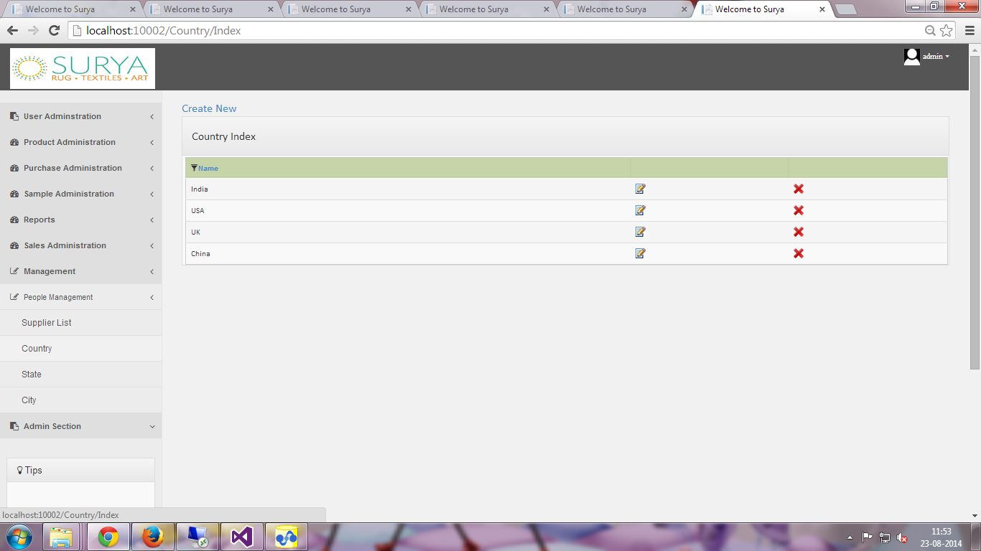
Country
Country | This page shows the list of countries . You can access this page under the People Management category from the Country tab.
Permission | Action | Narration | Roles
 | Create | You can create a new country using this link | Data Entry Operator, Manager, Inspection Manager, Admin
 | Modify | You can use this link to modify the country information. | Data Entry Operator, Manager, Inspection Manager, Admin
 | Delete | You can use this link to delete the country information. | Admin

Slide 46
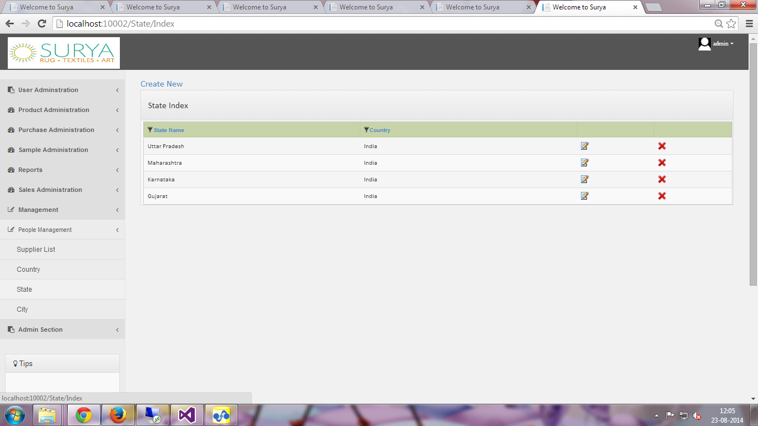
States
States | This page shows the list of States . You can access this page under the People Management category from the states tab.
Permission | Action | Narration | Roles
 | Create | You can create a new state using this link. While creating the new state information you have enter the name of the state and select the corresponding country. | Data Entry Operator, Manager, Inspection Manager, Admin
 | Modify | You can use this link to modify the state information. | Data Entry Operator, Manager, Inspection Manager, Admin
 | Delete | You can use this link to delete the state information. | Admin

Slide 47
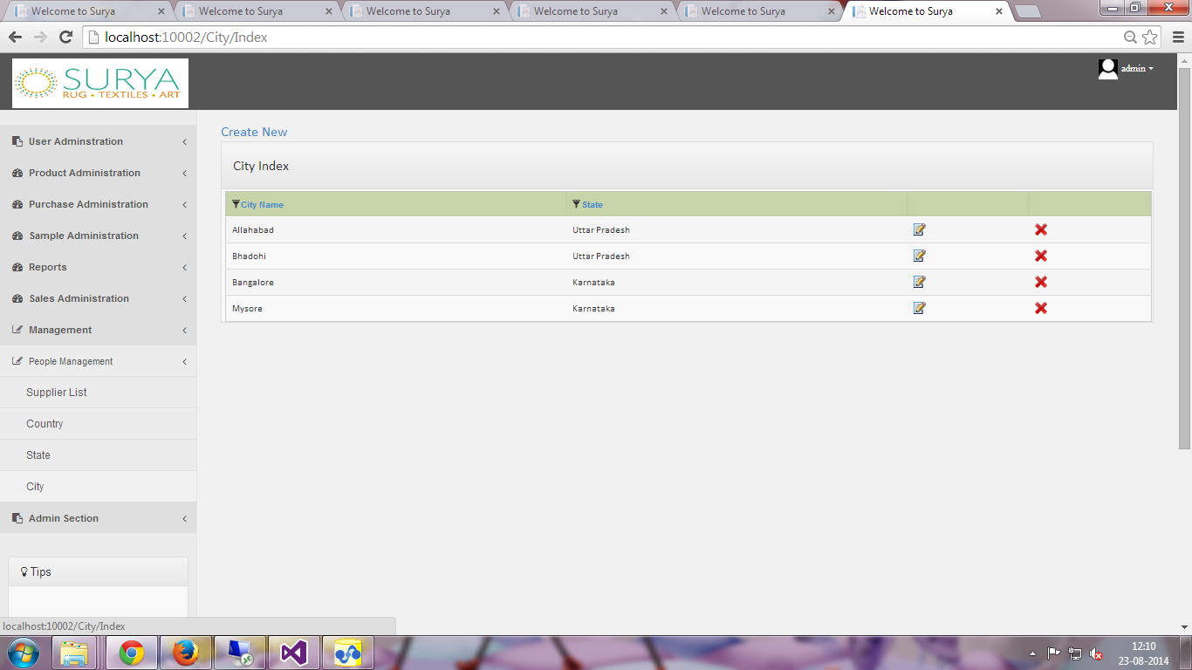
City
City | This page shows the list of Cities. You can access this page under the People Management category from the City tab.
Permission | Action | Narration | Roles
 | Create | You can create a new city using this link. After filling the name of the city and selecting the appropriate country and state information click the save button to save the city. | Data Entry Operator, Manager, Inspection Manager, Admin
 | Modify | You can use this link to modify the city information. | Data Entry Operator, Manager, Inspection Manager, Admin
 | Delete | You can use this link to delete the city information. | Admin

